Slide 1
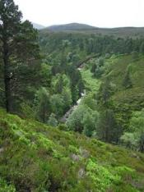
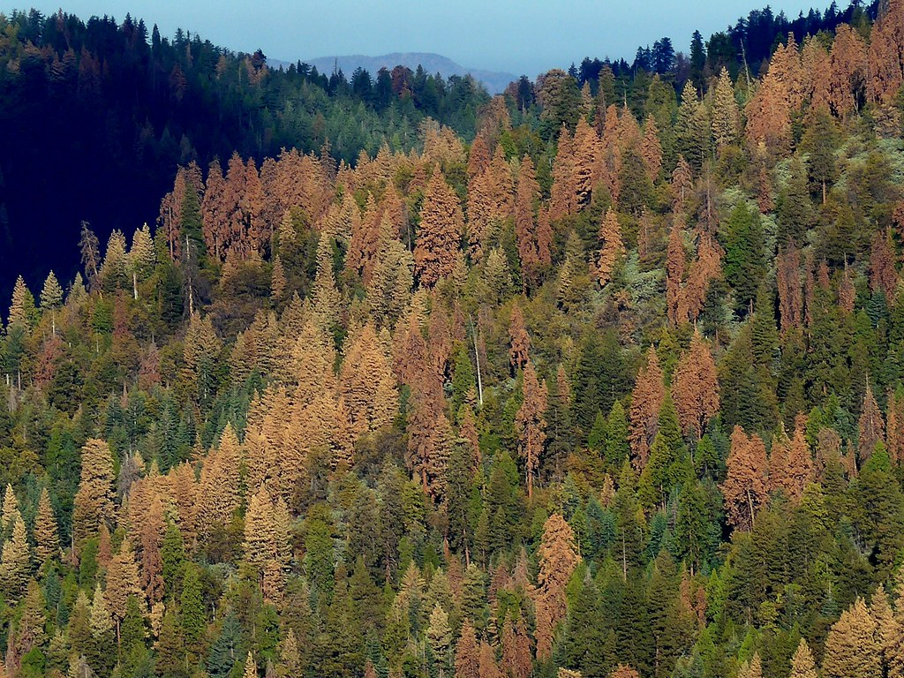

Probabilistic Risk Analysis (PRA) and Bayesian Decision Theory (BDT)
Marcel van Oijen
(Independent scientist,
Edinburgh, U.K.)
Mark Brewer
(Biomathematics and
Statistics Scotland)
USGS CC PDM 1.0
Workshop IBS-Germany & DVFFA, Lübeck, 2025-09-24-26

Slide 2
Contents
Introduction to PRA: Basic ideas & equations
Model-based PRA
Beyond the basic theory
Introduction to BDT
Links between PRA and BDT
General discussion
Contents based on Van Oijen & Brewer (2022), with extensions and some corrections
Exercises - simple calculation or R-programming - to initiate discussion
Main questions to all:
What is missing from these lectures and/or VO & B (2022)?
Which of the methods could you use in your own work?

Slide 3
1. Introduction to PRA: Basic ideas & equations
USGS CC PDM 1.0
Workshop IBS-Germany & DVFFA, Lübeck, 2025-09-24-26

Slide 4
Terminological confusion
HAZARD | PROBABILITY OF HAZARD | VULNERABILITY
Initiating event | Probability of undesirable consequences | (Severity of) consequences
Threatening event | Exposure | (Degree of) loss
Potentially damaging agent |  | Biophysical v., Socio-economic v.
Natural disaster |  | Contextual v., Outcome v.
Natural hazards |  | Susceptibility (to damage)
 |  | Sensitivity
 |  | Fragility
 |  | Impact
 |  | Damageability

Slide 5
Terminological confusion
Lecina-Diaz et al. (2020):
“where E are the exposed values (here represented by the ES
provided by a forest), HM is the hazard magnitude (weighted
by its probability distribution), S is susceptibility, and LAC is
the lack of adaptive capacity within a given time frame”
IPCC (2014):
“Risk is often represented as probability of occurrence of hazardous events or trends multiplied by the impacts if these events or trends occur. Risk results from the interaction of vulnerability, exposure, and hazard.”
“Vulnerability: The propensity or predisposition to be adversely affected. Vulnerability encompasses a variety of concepts and elements including sensitivity or susceptibility to harm and lack of capacity to cope and adapt.”

Slide 6
Risk matrices
National Risk Register (2017)
CAA (2014)

Slide 7
Risk matrices
p[H] × V = 3 × 4
p[H] × V = 4 × 3
p[H] × V = 5 × 2
What is the highest risk??
V
p[H]

Slide 8
Risk matrices
Can we define V and p[H] such that Risk = V * p[H] is well-defined ?
V
p[H]

Slide 9
Toward formal theory for PRA: Notation
Environment
x
System
z
H = Hazardous conditions
p[ x ∈ H ] = p[H] = Probability of hazardous conditions
E[ z ] = Expectation for system performance
E[ z | H ] = Expectation for system performance
under hazardous (”bad”) conditions
E[ z | ¬H ] = Expectation for system performance
under non-hazardous (“good”) conditions

Slide 10
PRA: basic equations
Standard definition of risk
Standard definition of hazard probability
Logical definition of vulnerability
Vulnerability (V) is the difference in expected system performance (E[z|.]) between non-hazardous (¬H) and hazardous conditions (H).

Slide 11
Data needs are minimal for basic PRA
Cause
Effect
“Hazardous conditions” = “rainfall <= 2 mm d⁻¹”
A:
B:
C:
D:
E:
E(sys|env non-hazardous) = 9 g m⁻² d⁻¹
E(sys|env hazardous) = 3 g m⁻² d⁻¹
Vulnerability = A-B = 6 g m⁻² d⁻¹
p[env hazardous] = 0.3
Risk = C*D = 1.8 g m⁻² d⁻¹
Note that Risk can also be calculated in the standard way as E[sys|env non-hazardous] – E[sys] = 9 - 7.2 = 1.8

Slide 12
A simple method for risk decomposition
E[sys]
RISK = Average loss
VULNERABILITY
thr
p[Hazardous] =
frequency env < thr =
n_{H} / n
RISK =
VULNERABILITY * p[Hazardous]

Slide 13
Example: Risk analysis for NPP
NPP in good years
VULNERABILITY
(= Difference NPP good-bad)
RISK
(= Prob.*VULNERABILITY)
NPP in bad years
Probability of bad years

Slide 14
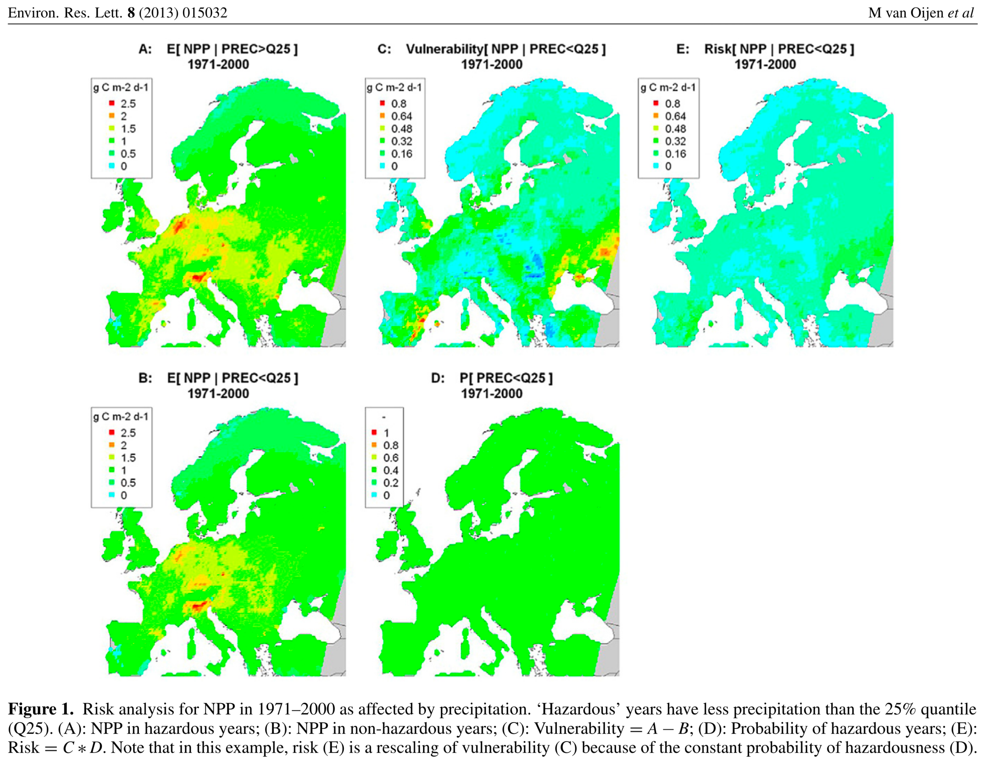
PRA coniferous forests (WATCH, EMEP, BASFOR)

Slide 15
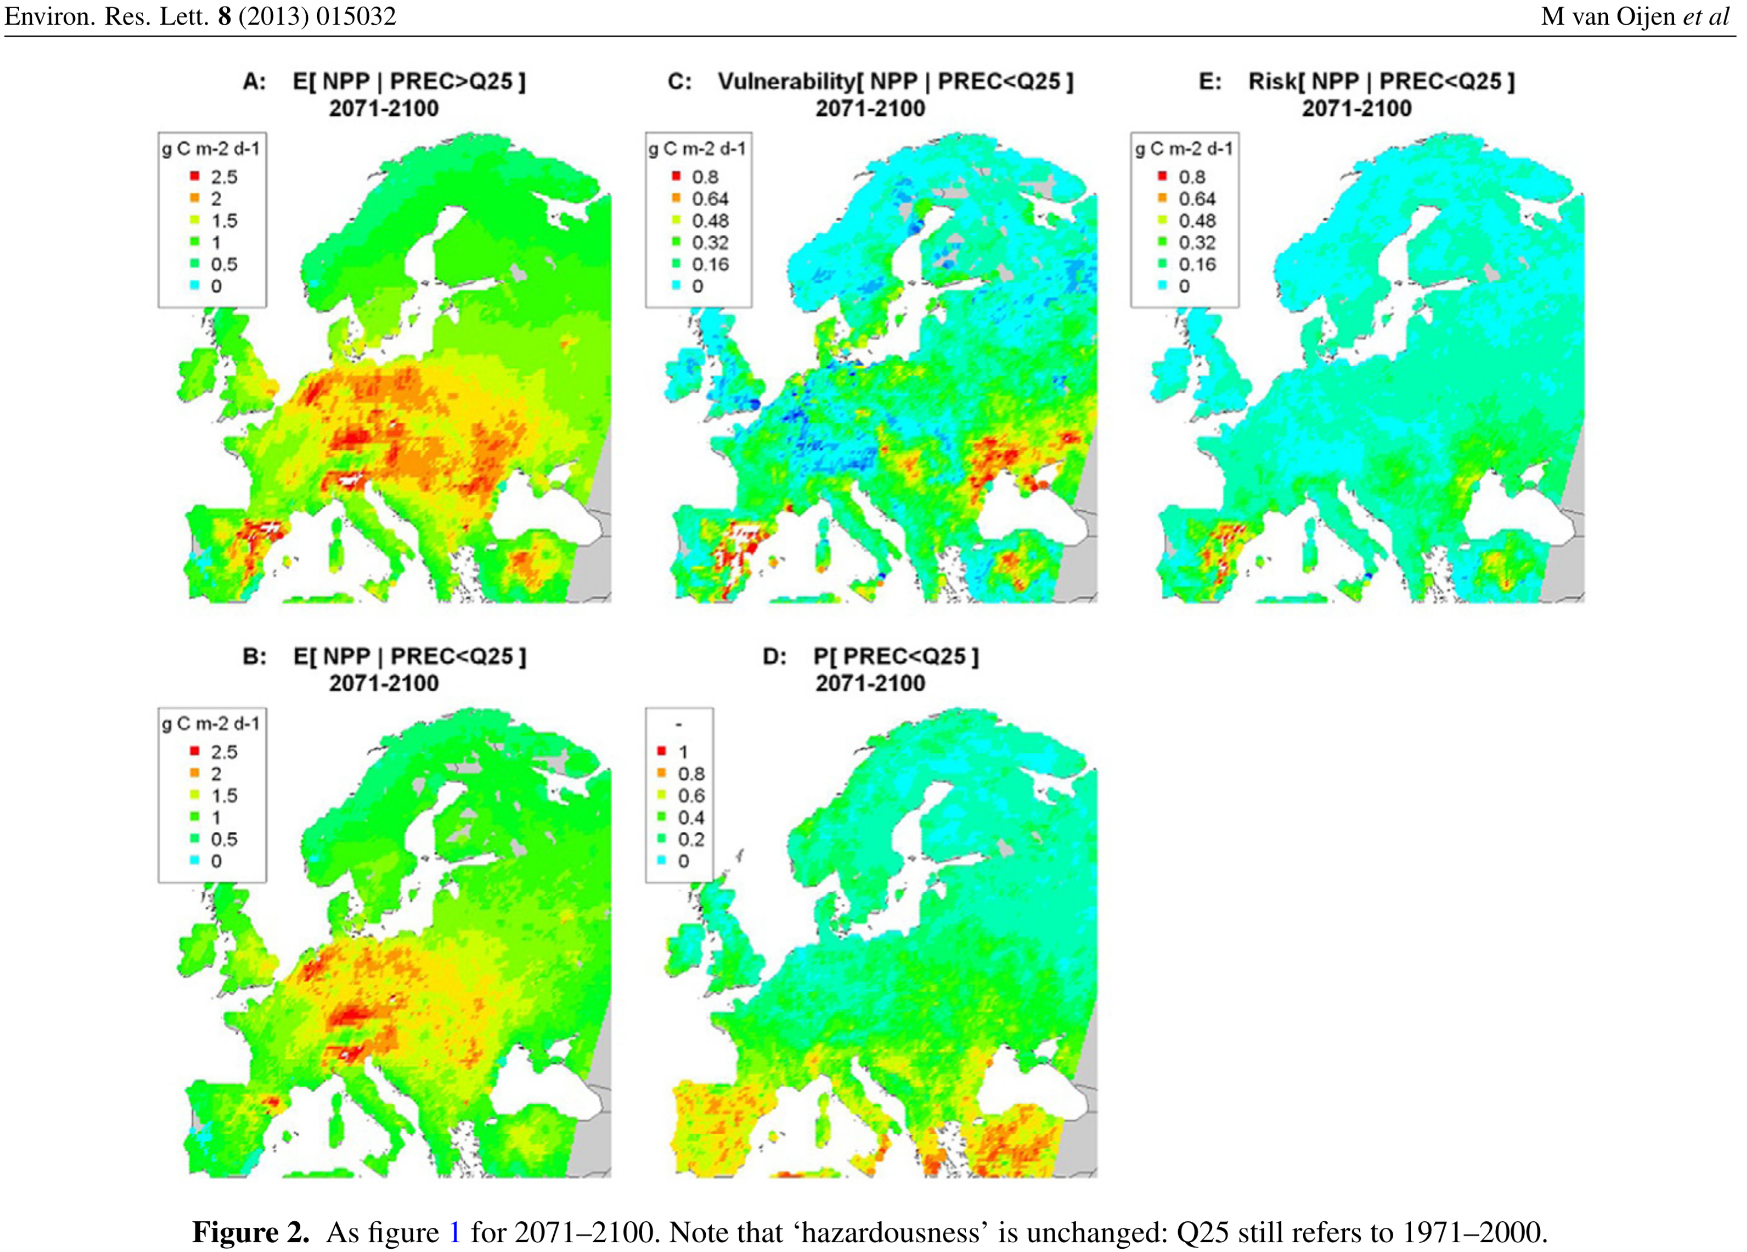
PRA coniferous forests (MPI-Remo, EMEP, BASFOR)

Slide 16
6 models: average NPP in 1971-2000
Van Oijen et al. (2014)
Biogeosciences

Slide 17
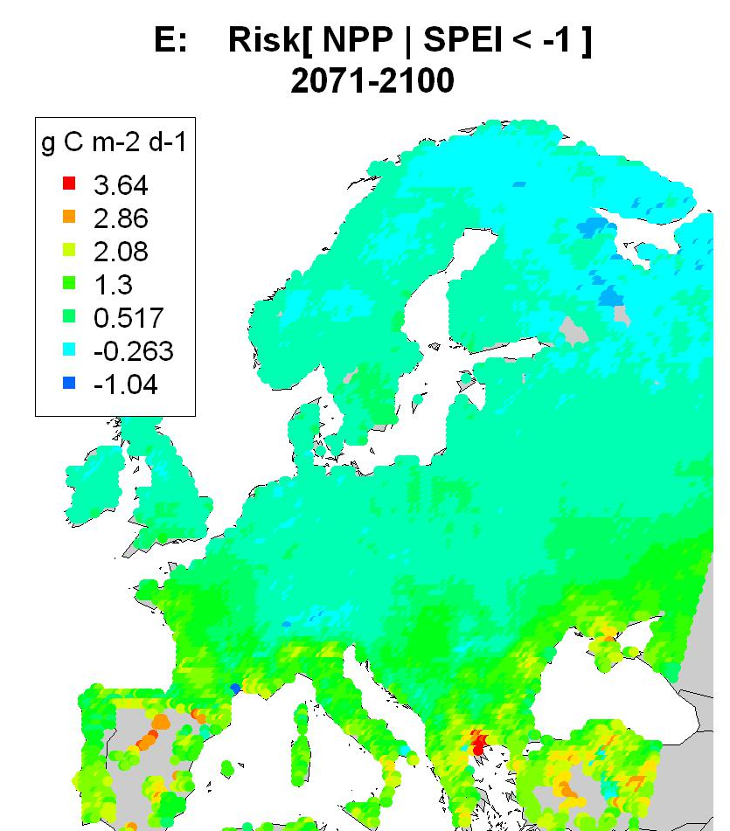
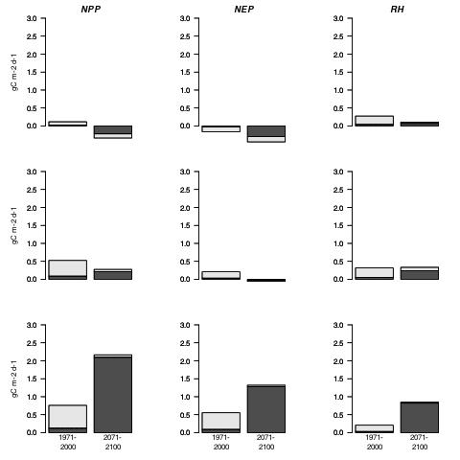
Risk analysis NPP (model LPJ) per latitudinal band
latitude > 55 °N
VULNERABILITY (high-latitude)
RISK (high-latitude)
45 < lat. < 55 °N
latitude < 45 °N
VULNERABILITY (mid-latitude)
RISK (mid-latitude)
VULNERABILITY (low-latitude)
RISK (low-latitude)

Slide 18
Risk analysis NPP (model LPJ) per latitudinal band
Left: 1971-2000, Right: 2071-2100

Slide 19
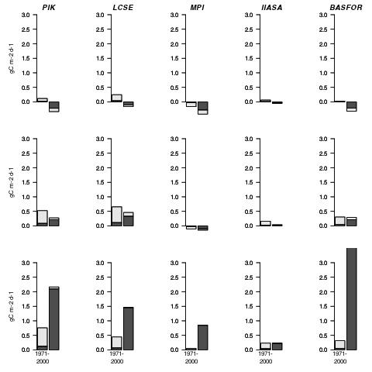
Risk analysis NPP: 5 models
LPJ
(generic)
ORCHIDEE
(generic)
JSBACH
(generic)
EPIC
(wheat)
BASFOR
(pine)

Slide 20
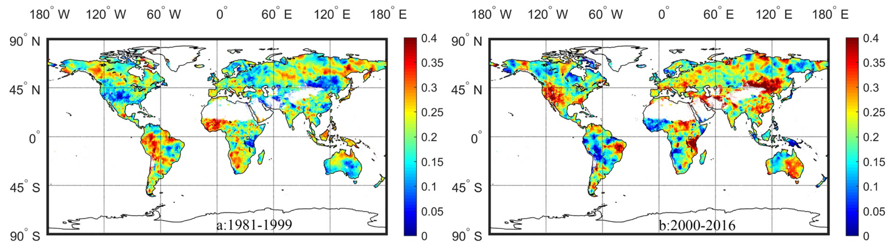
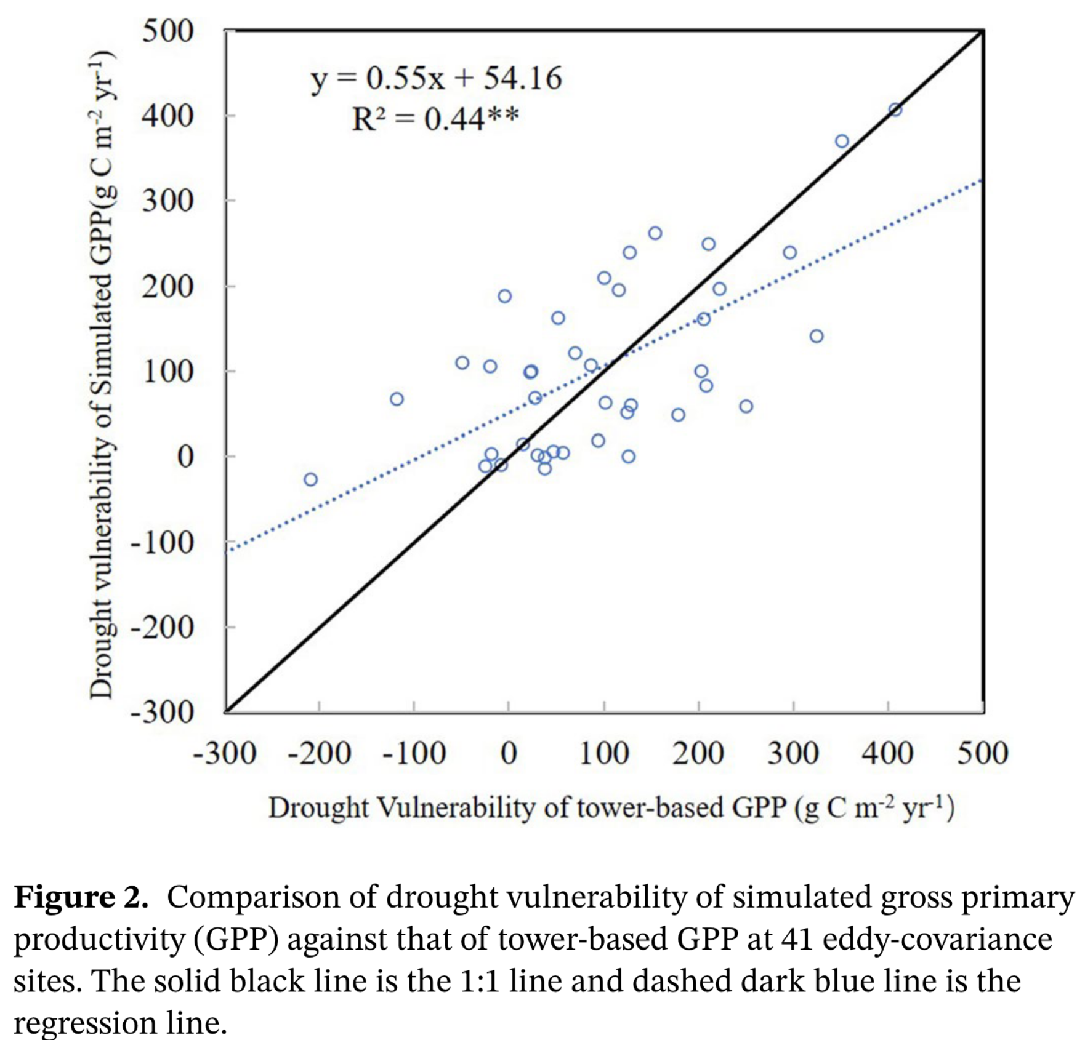
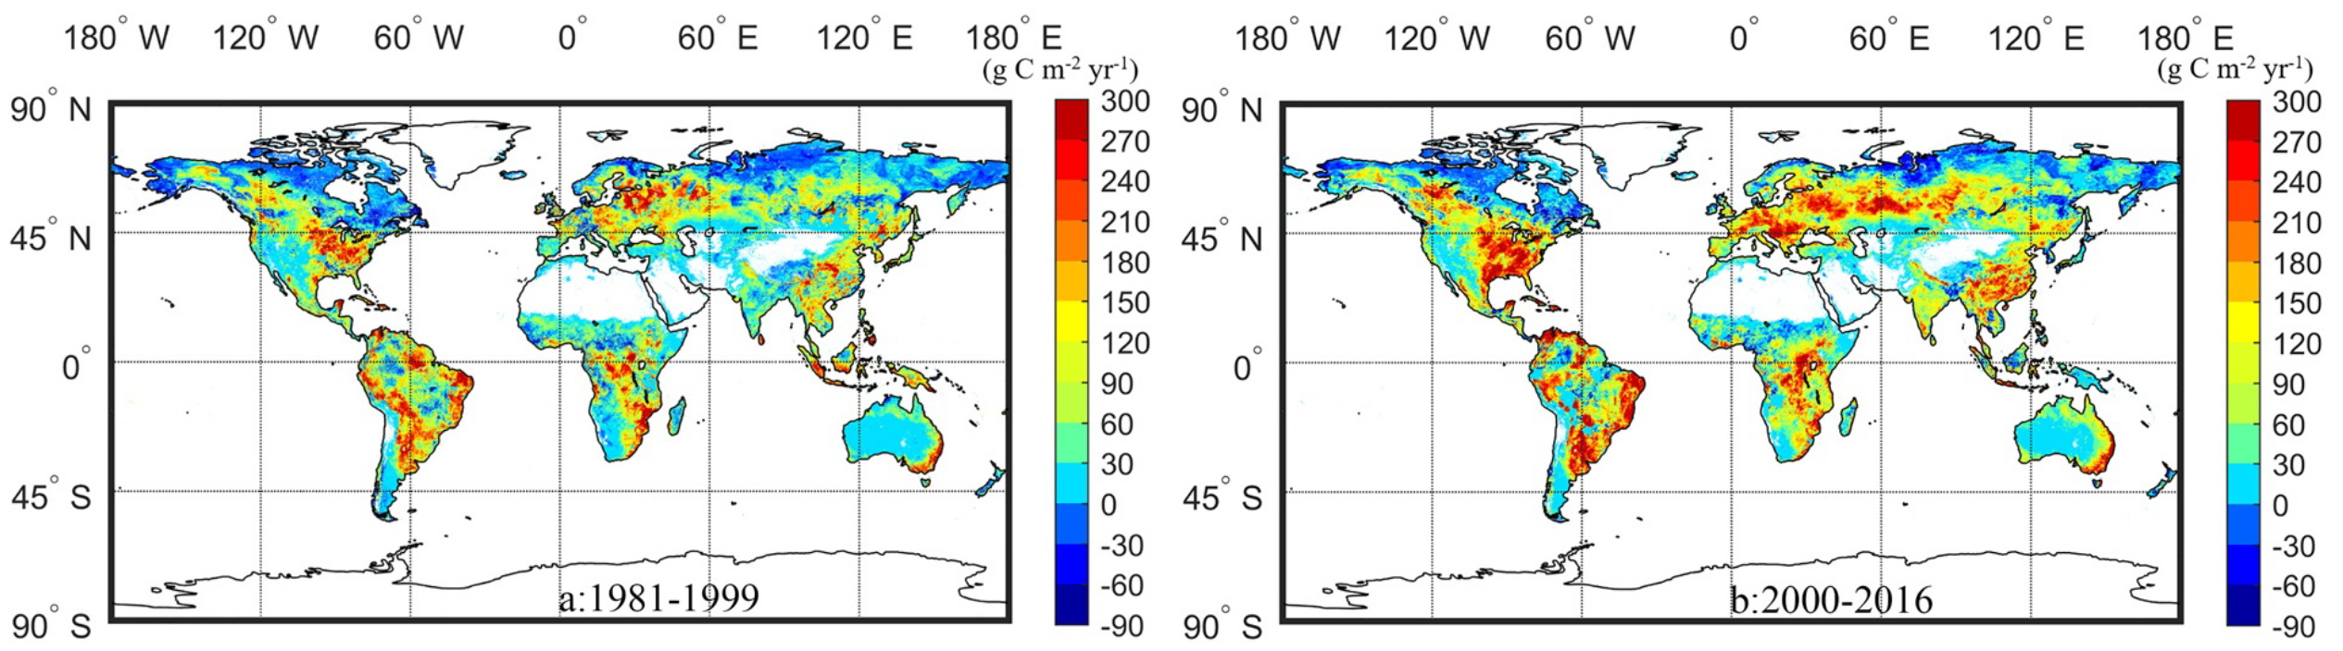
He et al. (2021). Drought Risk of Global Terrestrial Gross Primary Productivity Over the Last 40 YearsDetected by a Remote Sensing-Driven Process Model
1981-1999
2000-2016
p[H]
V

Slide 21
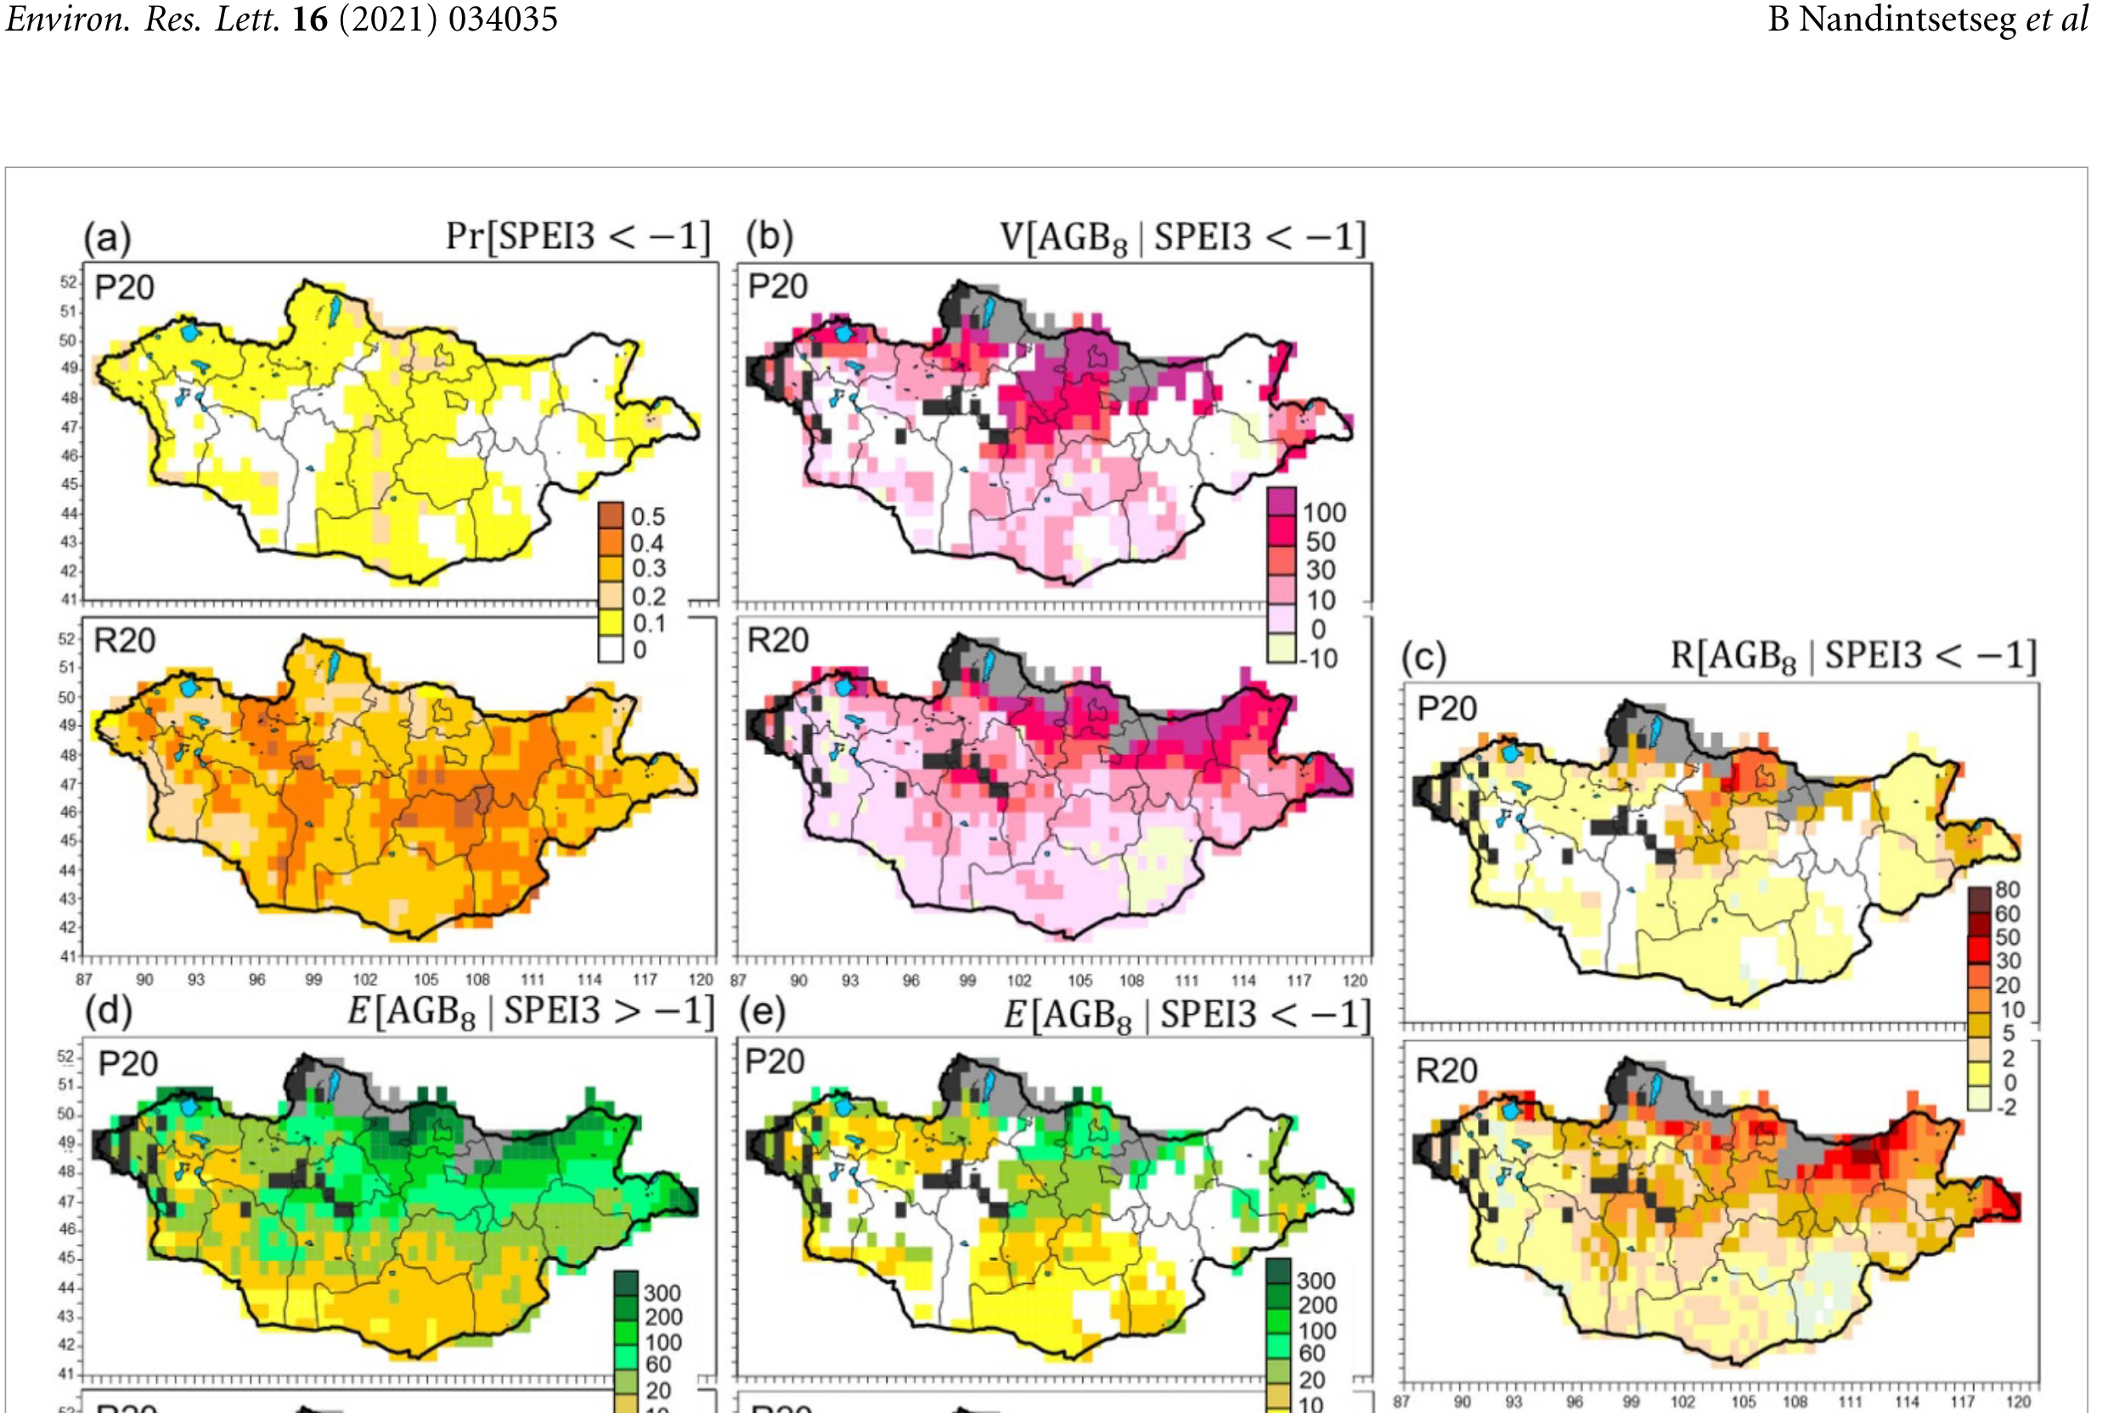
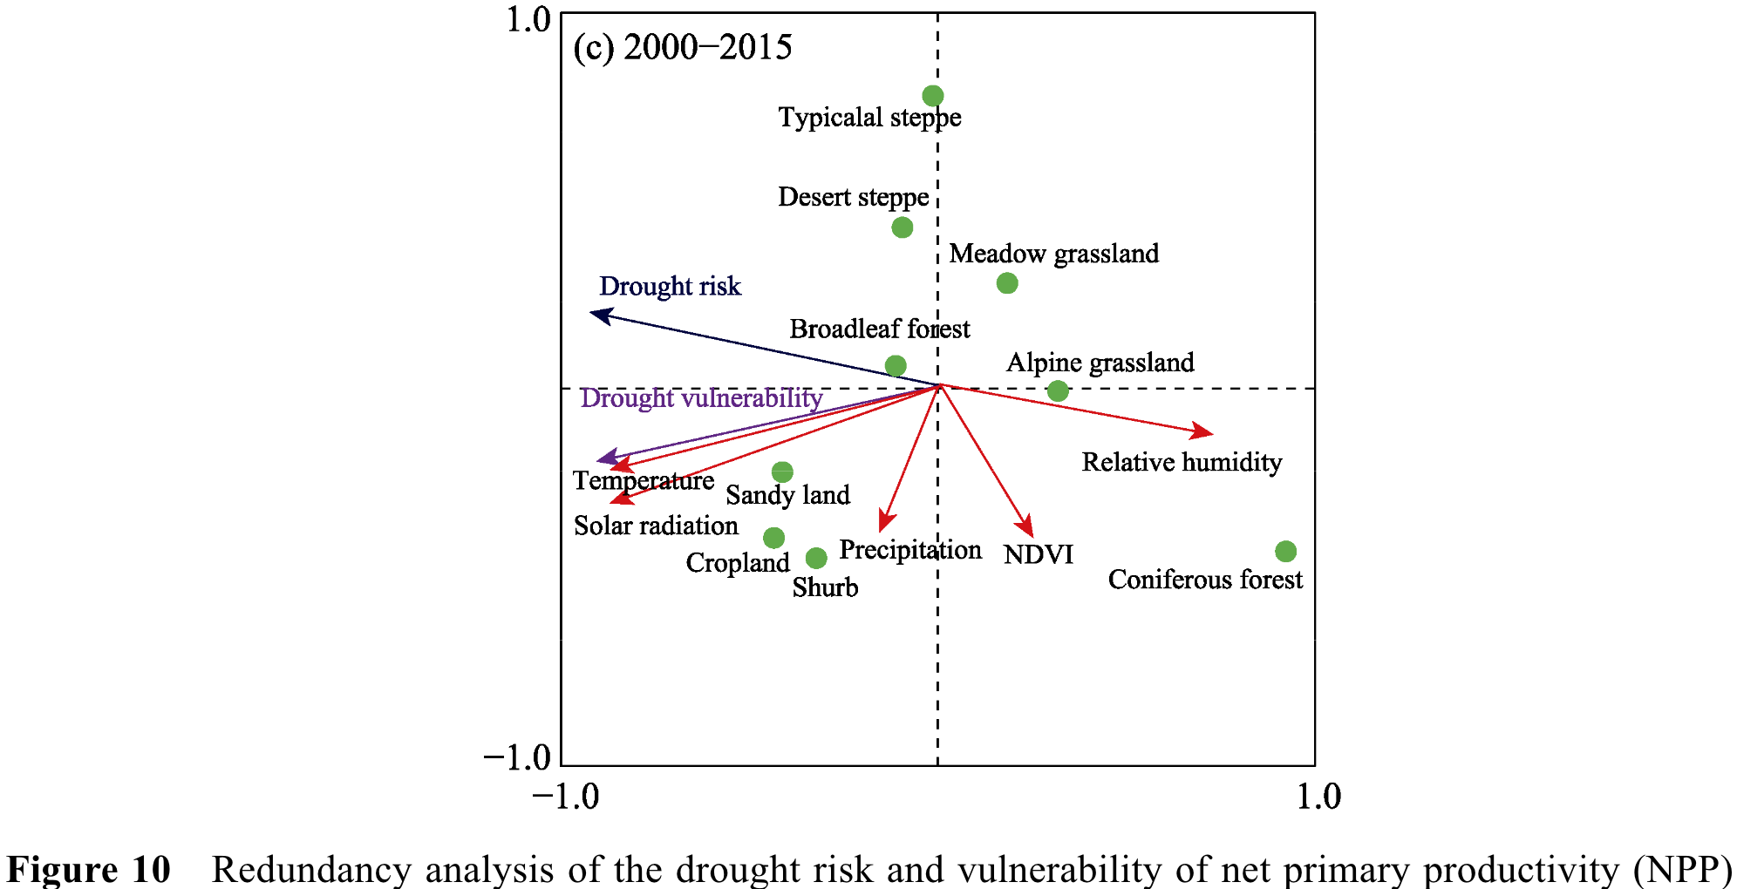
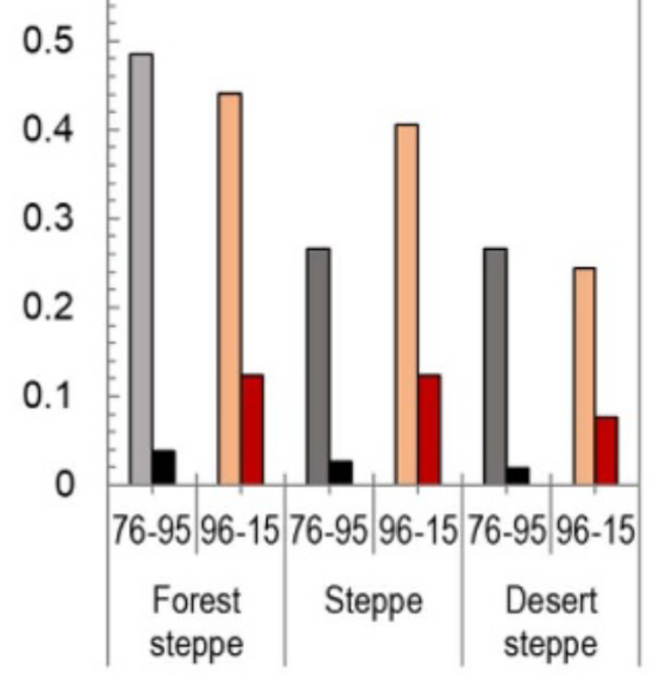
Nandintseg et al. (2021). Risk and vulnerability of Mongolian grasslands under climate change
p[H]
V
R
1976-1995
1996-2015
V
R
Ren et al. (2023)

Slide 22
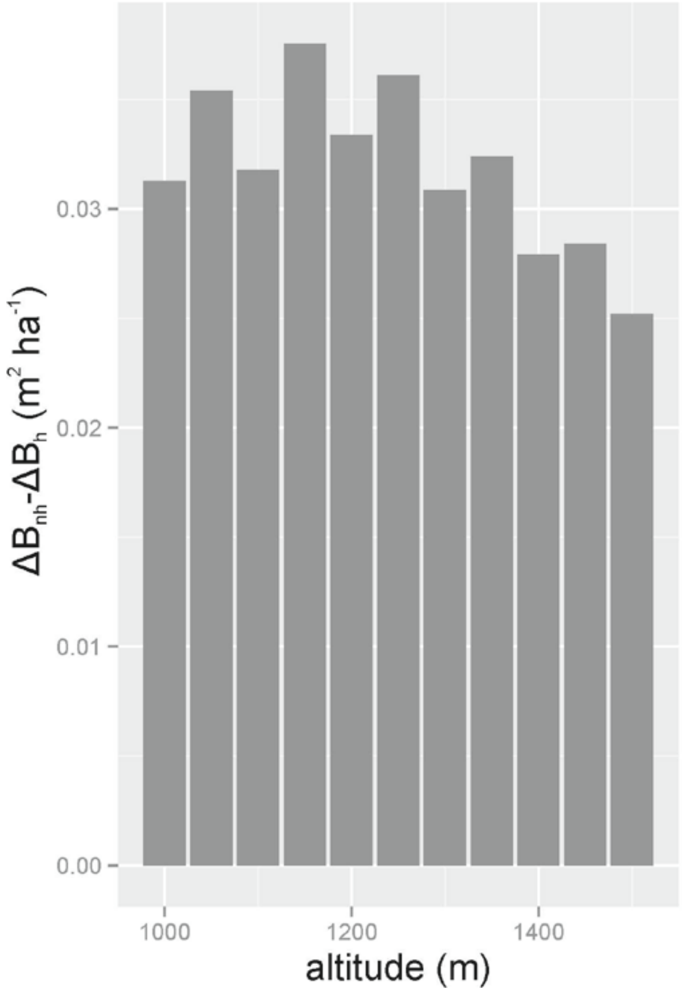
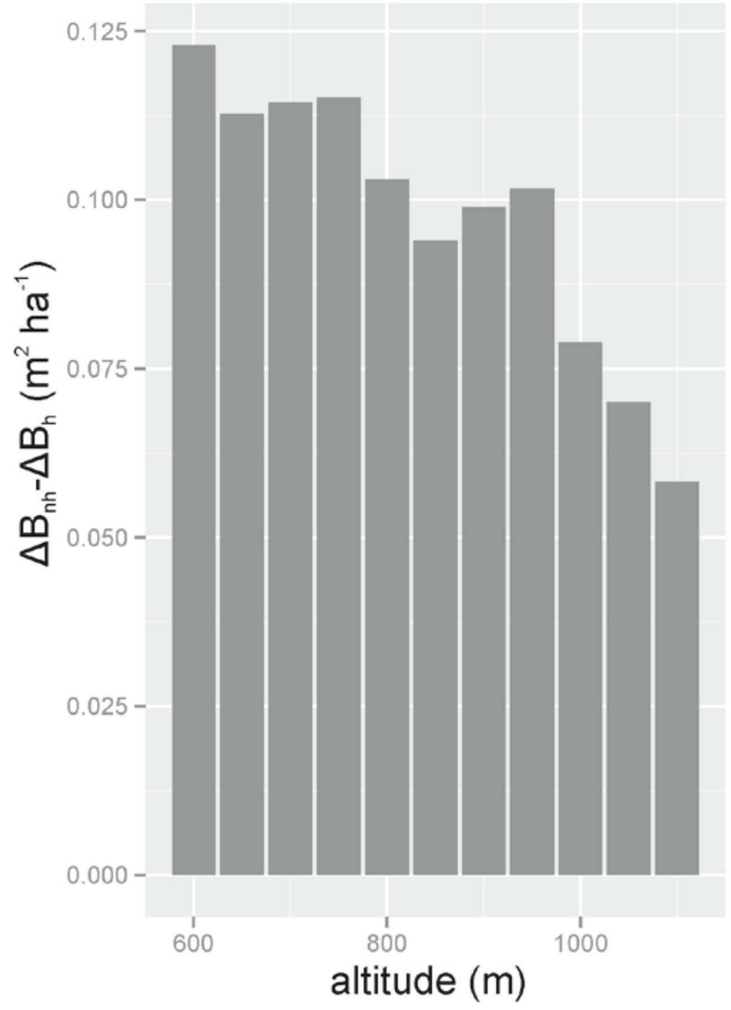
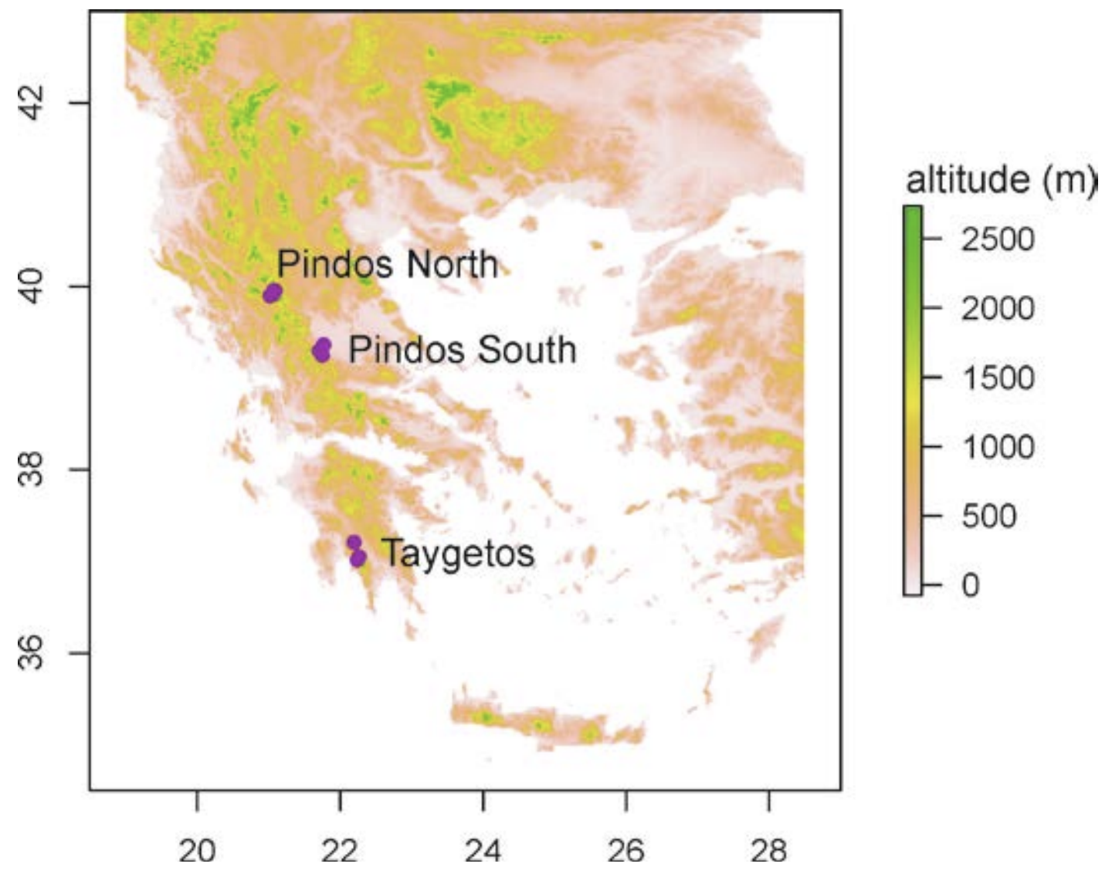
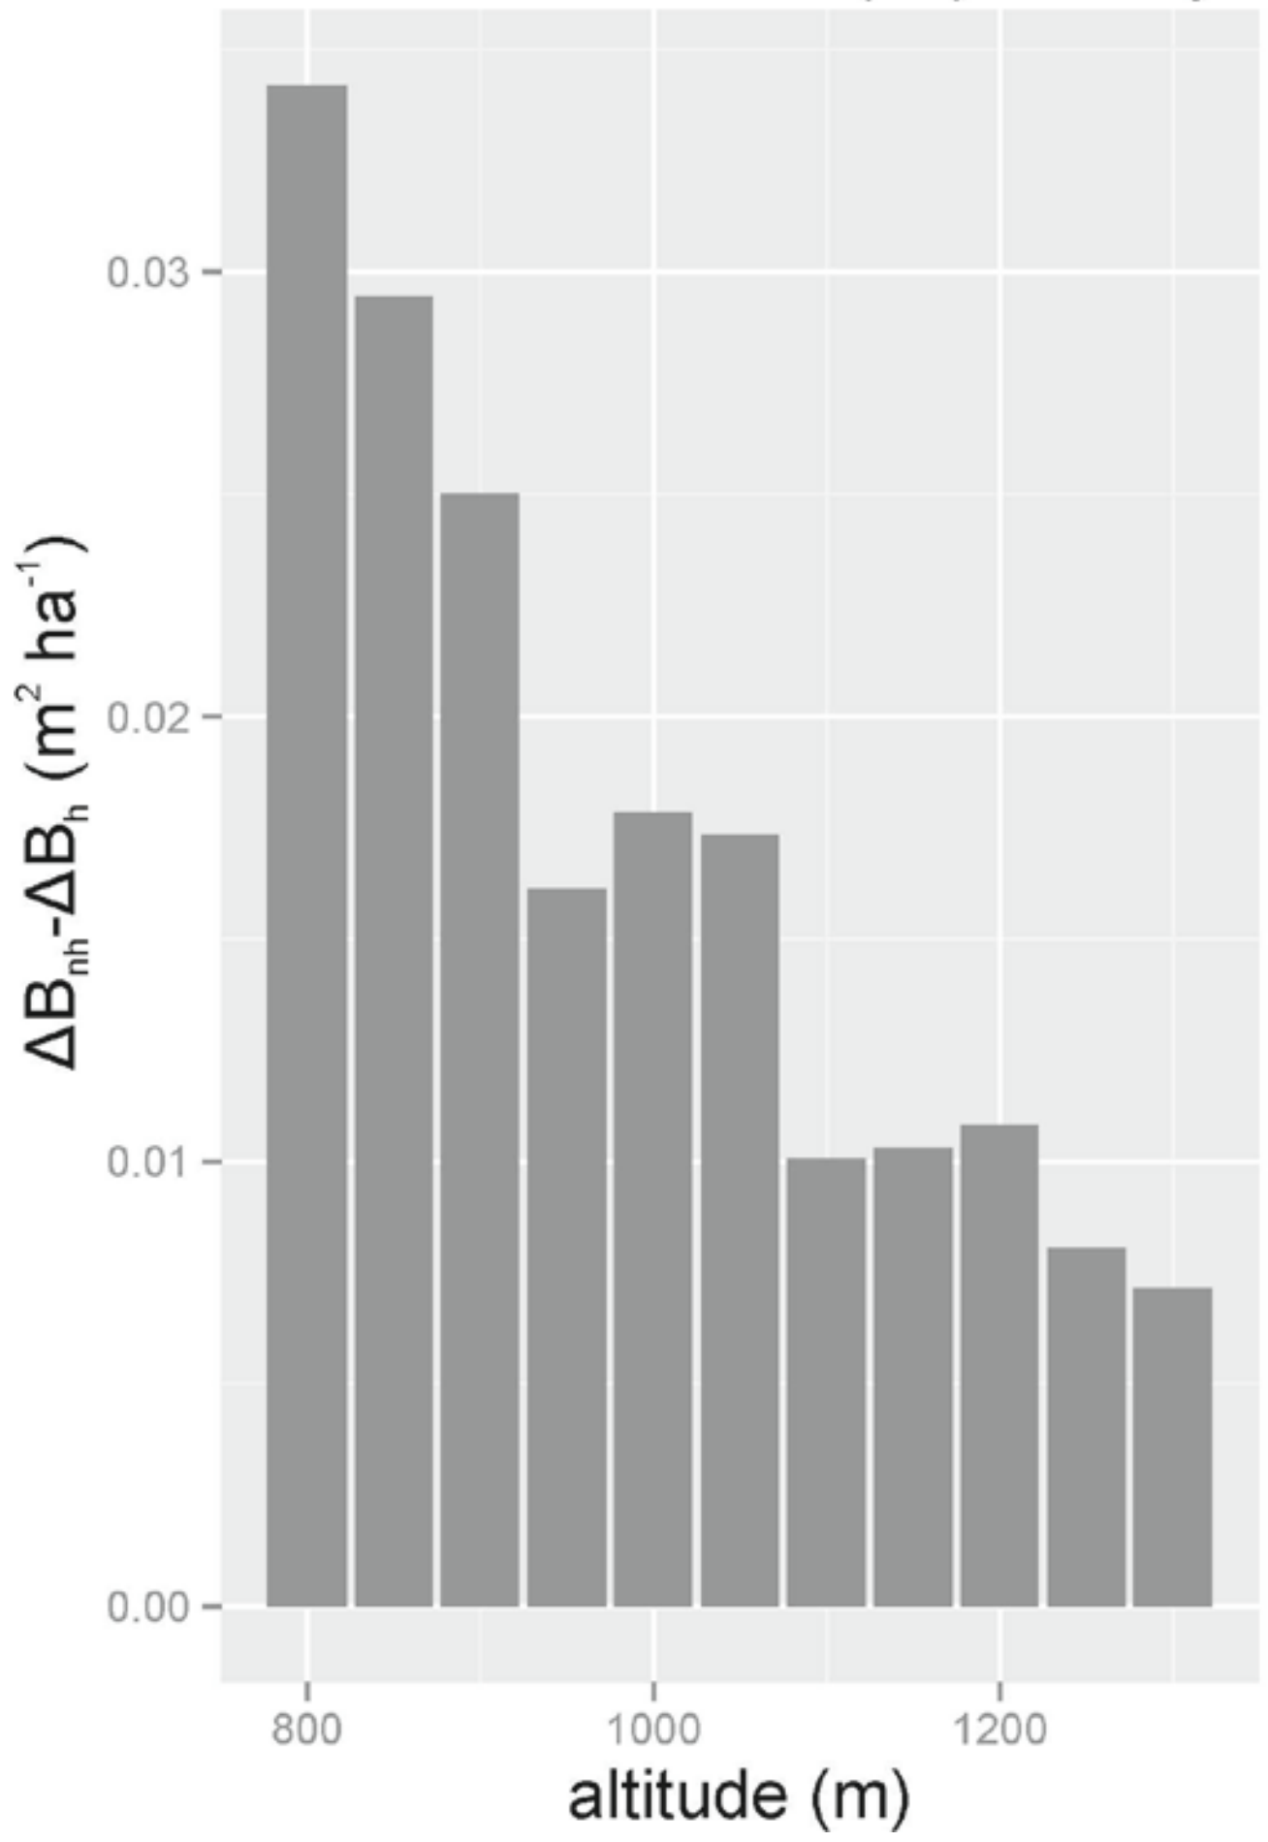
Fyllas et al. (2015). Mediterranean Forests in Transition (MEDIT): Deliverable No9
Vulnerability of tree growth to climate change as f(altitude)
V
V
V

Slide 23
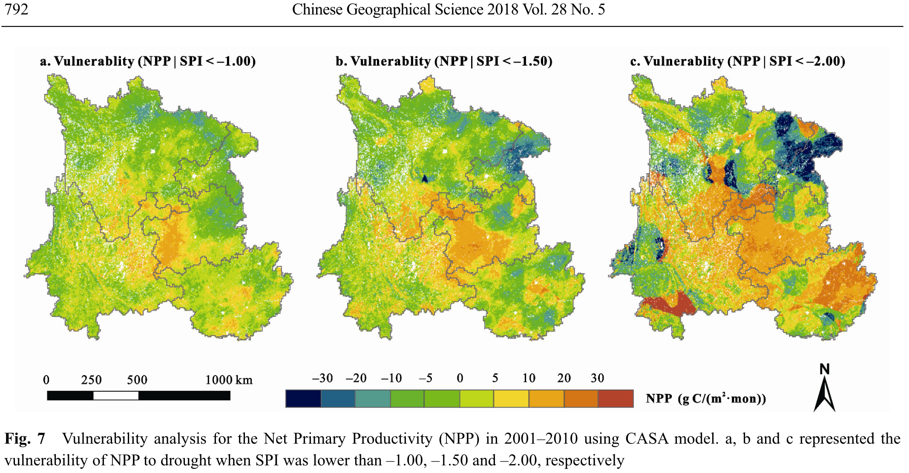
Zhou et al. (2018). Drought Impacts on Vegetation Indices and Productivity of Terrestrial Ecosystems in Southwestern China During 2001–2012

Slide 24
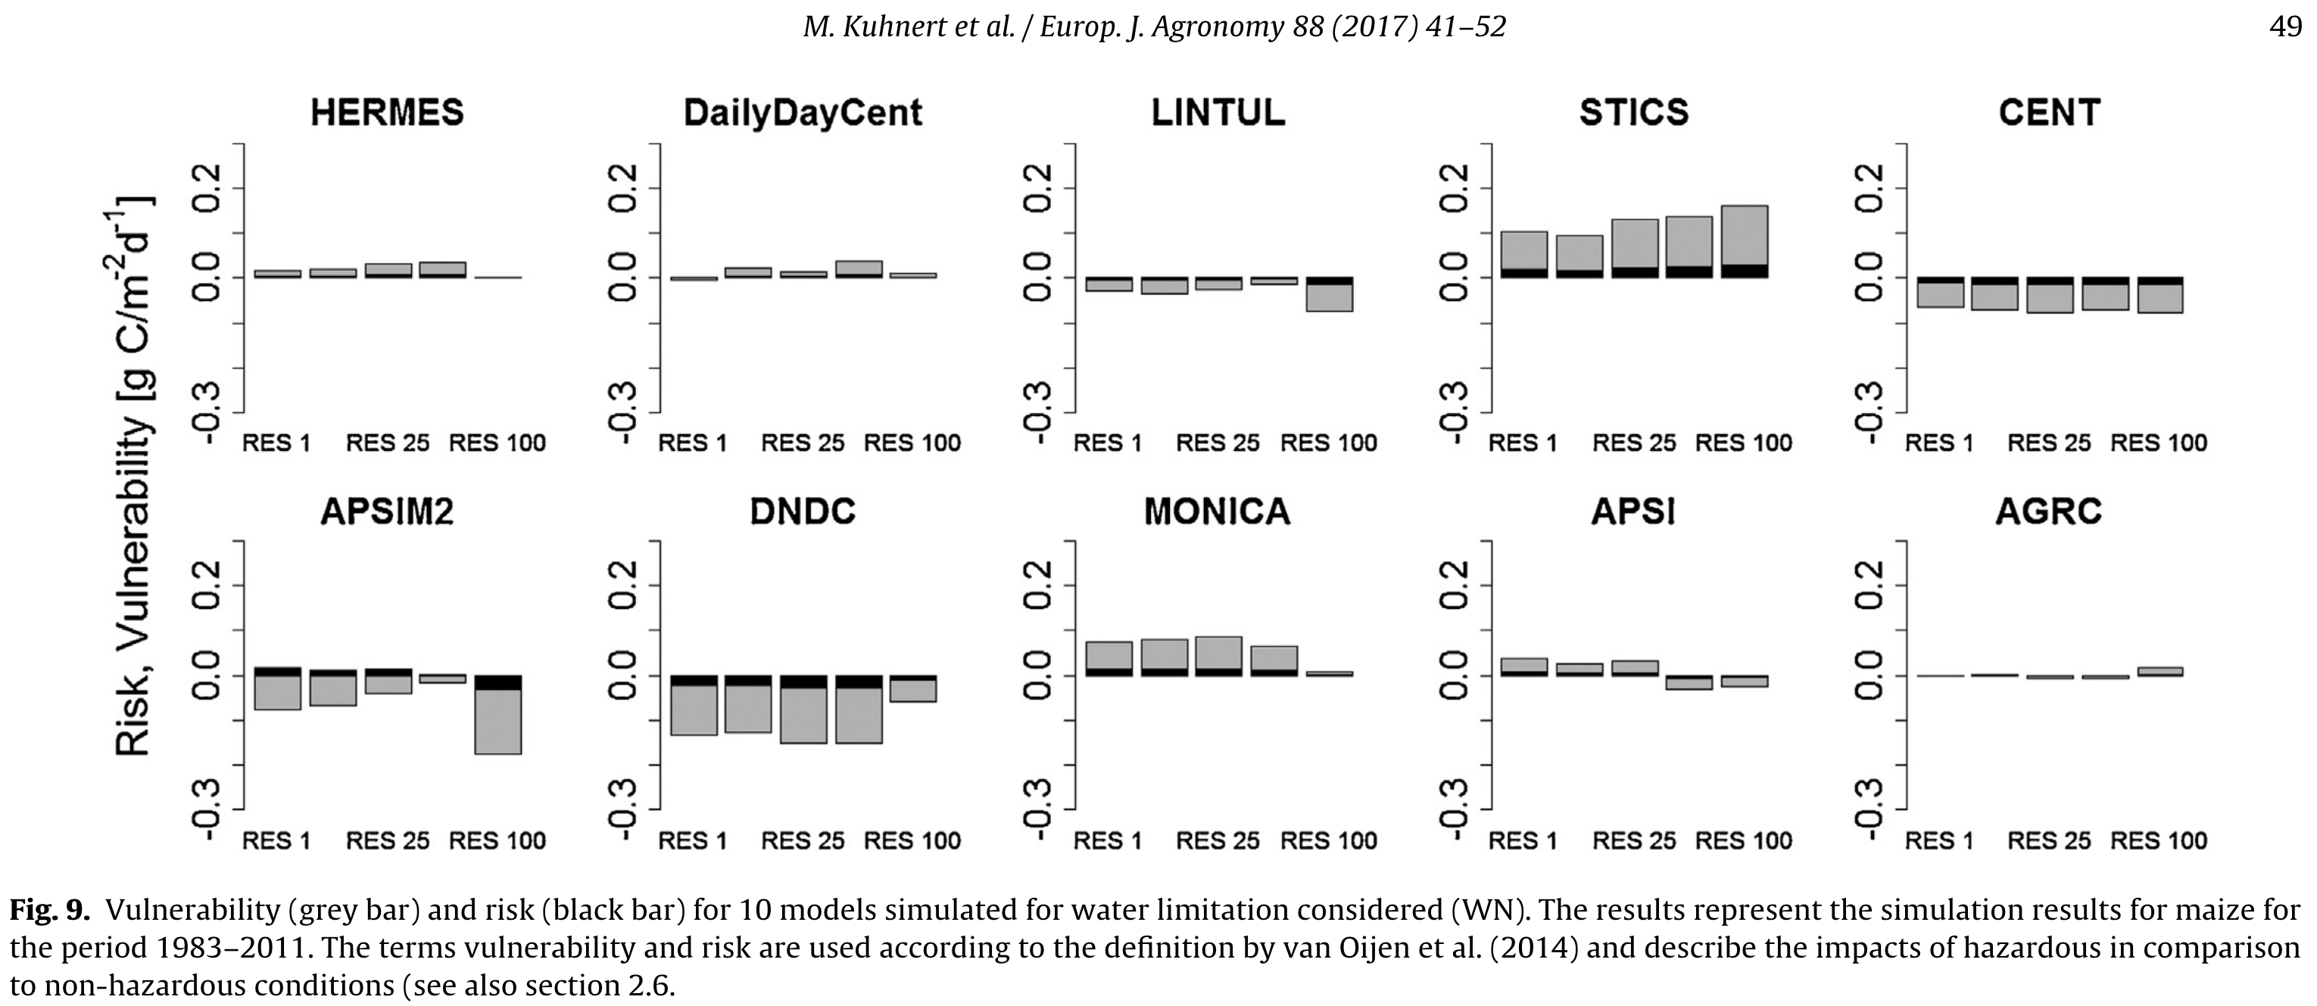
Kuhnert et al. (2017). Impact analysis of climate data aggregation at different spatial scales on simulated net primary productivity for croplands
Drought risk to NPP of maize in North Rhine-Westphalia
V,
R

Slide 25
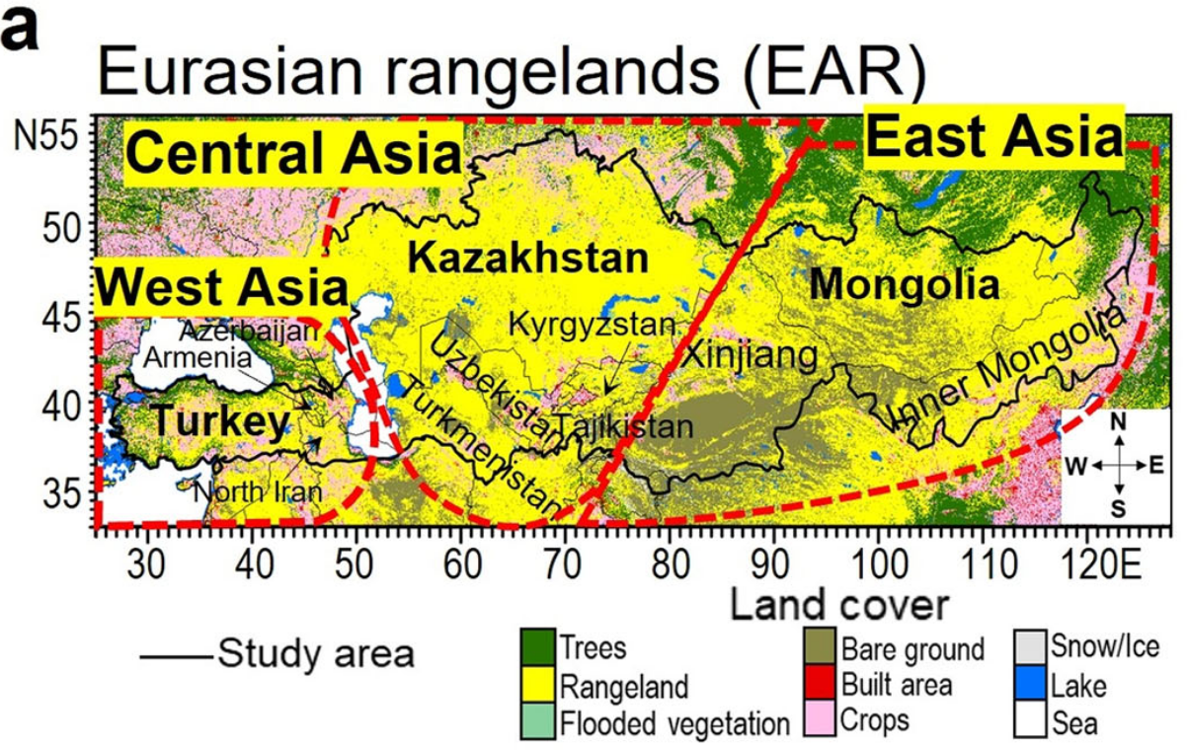
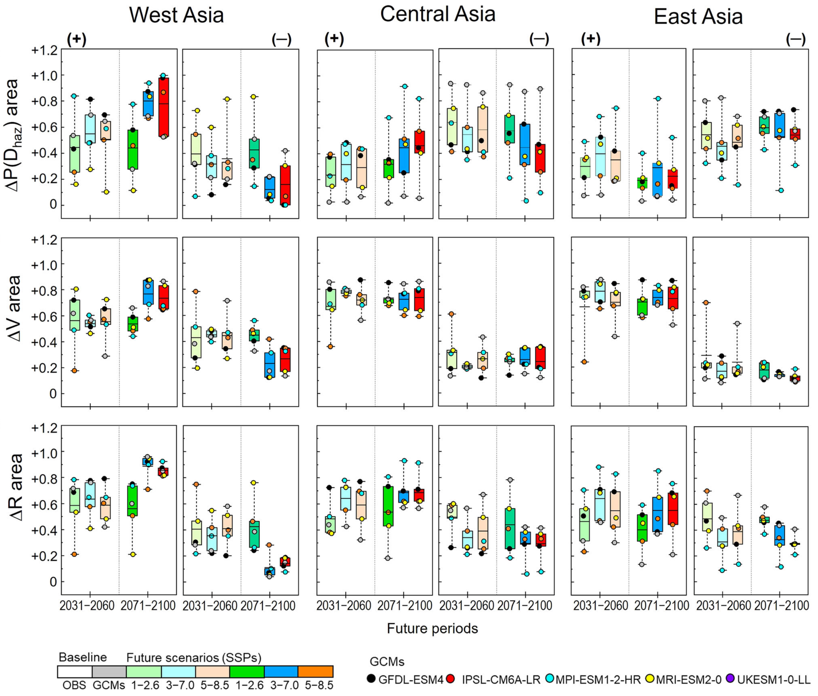
Nandintseg et al. (2024). Future drought risk and adaptation of pastoralism in Eurasian rangelands
Uncertainty p[H]
Uncertainty p[H]

Slide 26
Toward UQ (Uncertainty Quantification)
thr
n_{H} observations below threshold
n-n_{H}
observations above threshold

Slide 27
Toward UQ (Uncertainty Quantification)
E[sys]
R
V
thr
p[H] = n_{H} / n

Slide 28
Uncertainty Quantification (UQ)
E[sys]
R
V
thr
p[H] = n_{H} / n

Slide 29
R-function for single-threshold sampling-based PRA
PRA <- function( x, z, thr=0 ) {
n <- length(x)
H <- which(x < thr) ; n_H <- length(H)
Ez_H <- mean( z[ H] )
Ez_NotH <- mean( z[-H] )
s_Ez_H <- sqrt( var(z[ H]) / n_H )
s_Ez_NotH <- sqrt( var(z[-H]) / (n-n_H) )
pH <- n_H / n
V <- Ez_NotH - Ez_H
R <- pH * V
s_pH <- sqrt( pH*(1-pH) / n )
s_V <- sqrt( s_Ez_H^2 + s_Ez_NotH^2 )
s_R <- sqrt( s_pH^2*s_V^2 + s_pH^2*V^2 + pH^2*s_V^2 )
return( c(pH=pH, V=V, R=R, s_pH=s_pH, s_V=s_V, s_R=s_R) )
}

Slide 30
UQ: 1000 datasets from same distribution, thr=1
p[H] = 0.27, V = 0.464, R = 0.124
𝞂_{pH} = 0.04 , 𝞂_{V} = 0.040, 𝞂_{R} = 0.018
p[H] = 0.33, V = 0.410, R = 0.135
𝞂_{pH} = 0.05. , 𝞂_{V} = 0.035, 𝞂_{R} = 0.019
p[H] = 0.27, V = 0.464, R = 0.124
𝞂_{pH} = 0.04 , 𝞂_{V} = 0.039, 𝞂_{R} = 0.019

Slide 31
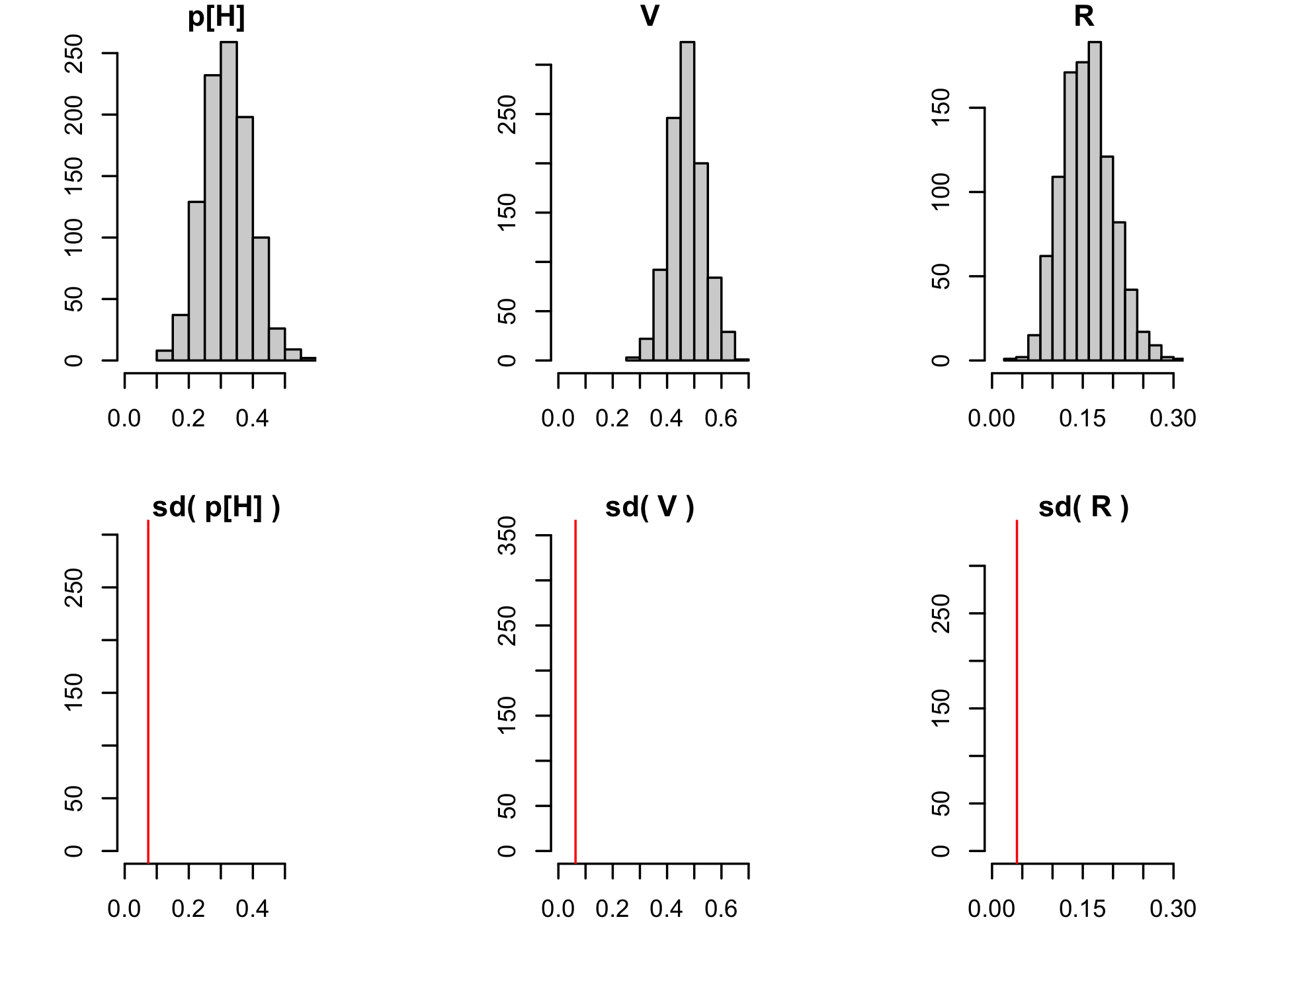
UQ: 1000 datasets from same distribution, thr=1

Slide 32
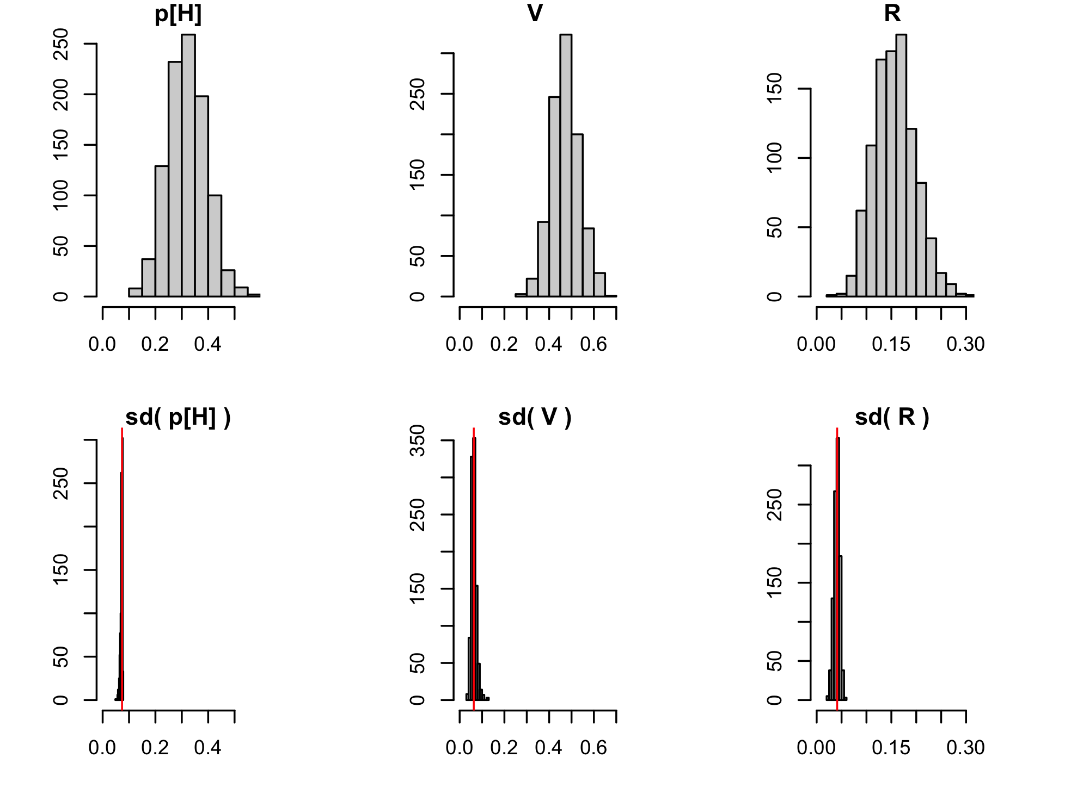
UQ: 1000 datasets from same distribution, thr=1

Slide 33
EXERCISE. Minimal data sets (sampling-based PRA)
x <- c( 200, 600 )
z <- c( 70, 90 )
PRA( x, z, 500 )
Will the uncertainty quantification work?
x <- c( 200, 400, 600, 800 )
z <- c( 70, 80, 90, 100 )
PRA( x, z, 500 )
Will the uncertainty quantification work?

Slide 34
EXERCISE. Minimal data sets (sampling-based PRA)
x <- c( 200, 600 )
z <- c( 70, 90 )
PRA( x, z, 500 )
pH V R s_pH s_V s_R
0.5 20.0 10.0 0.3535534 NA NA
x <- c( 200, 400, 600, 800 )
z <- c( 70, 80, 90, 100 )
PRA( x, z, 500 )
pH V R s_pH s_V s_R
0.5 20.0 10.0 0.25 7.0710678 6.373774

Slide 35
Forest data from Germany
https://www.umweltbundesamt.de/daten/klima/
2-bis-7_abb-tab_nsh_2024-04-08.xlsx
https://wo-apps.thuenen.de/apps/wze/
absterberate_EI_GFI_GKI_RBU_zeitreihe.csv
library( readxl )
d.data <- "data_Germany/"
file.data <- paste0( d.data, "2-bis-7_abb-tab_nsh_2024-04-08.xlsx" )
sheet.data <- "5_Daten” ; r.data <- "B120:C153"
y_r <- read_excel( file.data, sheet=sheet.data, range=r.data,
col_names=F )
y_r <- round( as.matrix(y_r) )
colnames(y_r) <- c( "year", "rain.mm" )
file.data <- paste0( d.data, "absterberate_EI_GFI_GKI_RBU_zeitreihe.csv" )
y_m <- read.csv2( file.data )
colnames(y_m) <- c( "year", "mort.%.Fs", "mort.%.Q_", "mort.%.Pa", "mort.%.Ps" )
y_r_m <- cbind( y_r, y_m[ , startsWith( colnames(y_m), "mort" ) ] )

Slide 36
Forest data from Germany
# Annual mortality vs. summer rain of last three years
meanlast <- function(v,k){as.vector(filter(v,f=rep(1/k,k),s=1))}
n <- dim(y_r_m)[1] ; k <- 3
r.3 <- meanlast(y_r_m[,"rain.mm"],k)[k:n]
z.Fs <- y_r_m[ k:n, "mort.%.Fs” ]
z.Q_ <- y_r_m[ k:n, "mort.%.Q_” ]
z.Pa <- y_r_m[ k:n, "mort.%.Pa” ]
z.Ps <- y_r_m[ k:n, "mort.%.Ps” ]
par ( mfrow=c(2,2) , mar=c(5,4,4,2) )
plot( r.3, z.Fs, main="Fs", xlab="" , ylab="mortality (%)" )
plot( r.3, z.Q_, main="Q_", xlab="" , ylab="" )
plot( r.3, z.Pa, main="Pa", xlab="rain (mm)", ylab="mortality (%)" )
plot( r.3, z.Ps, main="Ps", xlab="rain (mm)", ylab="" )

Slide 37
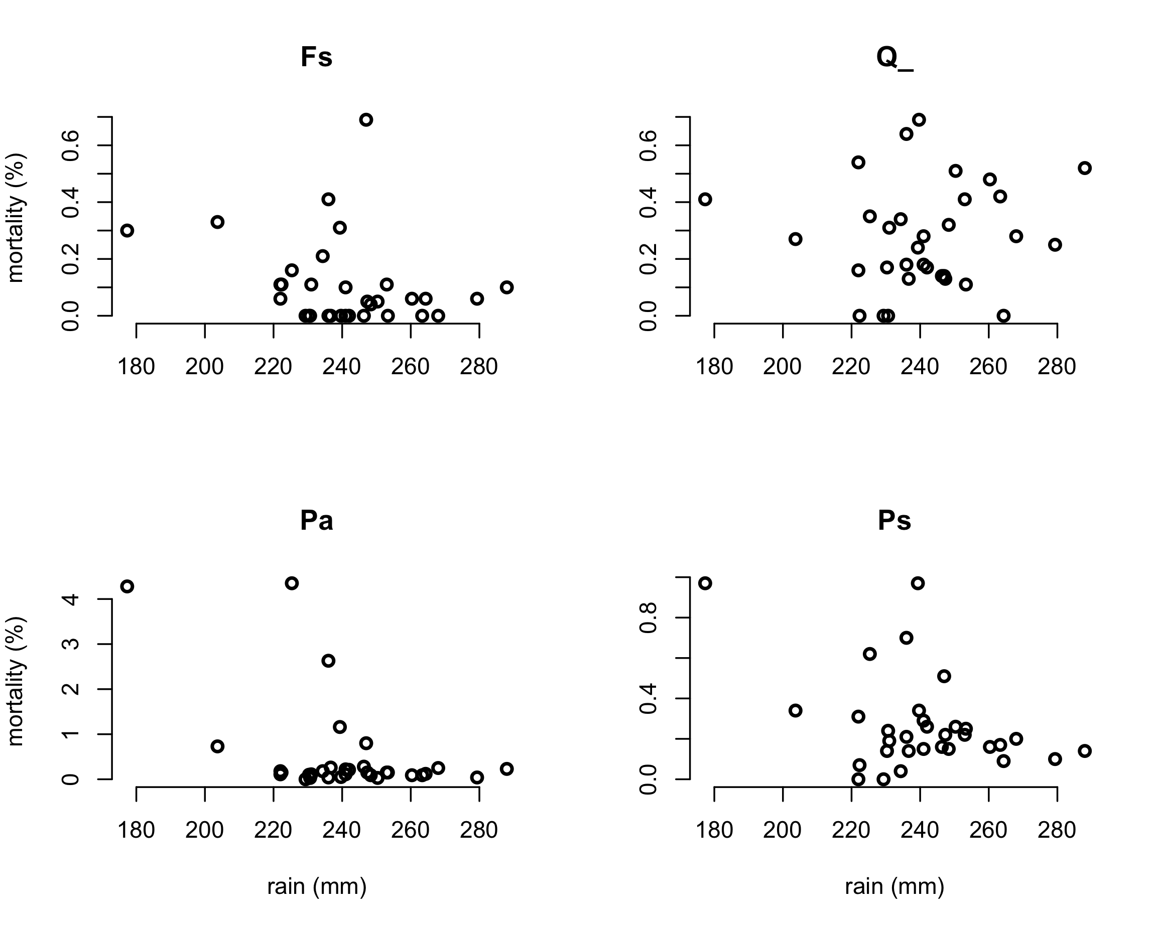
Forest data from Germany

Slide 38
Forest data from Germany: PRA
# PRA for survival (= 100 - mortality)
PRA_Ss.Fs <- PRA( x_r3, 100-z_Fs, thr=250 )
PRA_Ss.Q <- PRA( x_r3, 100-z_Q , thr=250 )
PRA_Ss.Pa <- PRA( x_r3, 100-z_Pa, thr=250 )
PRA_Ss.Ps <- PRA( x_r3, 100-z_Ps, thr=250 )
PRA._ <- as.matrix( cbind(PRA_Ss.Fs, PRA _Ss.Q_, PRA _Ss.Pa, PRA _Ss.Ps) )
colnames(PRA._) <- c( "Fs", "Q_", "Pa", "Ps" )
means <- PRA._[1:3,] ; s <- PRA._[4:6,]
par(mfrow=c(1,1))
col <- c( "red", "cyan", "yellow" )
bp <- barplot( means, beside=T, ylim=c(-0.2,1), col=col,
legend.text=row.names(means),
args.legend=list(x="top",hor=T) )
segments( bp, means - s, bp, means + s )
ew <- (bp[2,1]-bp[1,1])/4
segments( bp - ew, means - s, bp + ew, means - s )
segments( bp - ew, means + s, bp + ew, means + s )

Slide 39
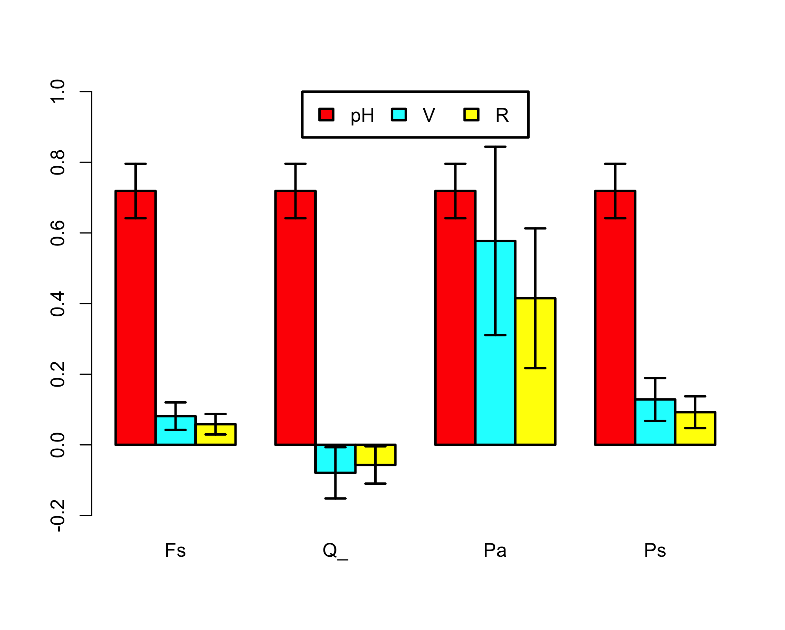
Forest data from Germany: PRA

Slide 40
Forest data from Germany: EXERCISE 1
Change the R-code: try other choices for the threshold. How does that affect the results?
Discuss limitations of the PRA.

Slide 41
Forest data from Germany: EXERCISE 1
Change the R-code: try other choices for the threshold. How does that affect the results?
Discuss limitations of the PRA. Possible answers:
Low n, large uncertainties.
Germany-average weather and mortality even though the tree species grow in different areas. p[H] the same for all species.
Arbitrary definition of hazard (average of last three summer-rain totals is less than thr = 250 mm).
Just one single hazard threshold.
No mechanistic understanding of causal factors, no gradual build-up of stress (increase of V) over years, no interactions with other hazard variables such as pests and diseases, …
No local definition of drought threshold (e.g. SPEI).
No normalised definitions of V and R.
…
Sometimes better! When?

Slide 42
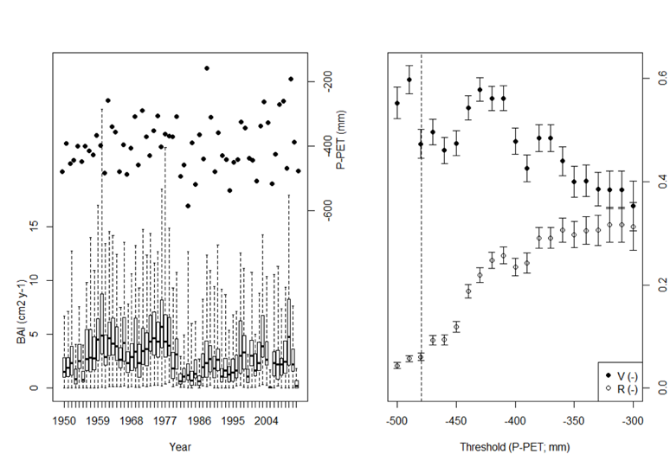
Van Oijen & Zavala (2019): P. sylvestris (El Carrascal, Spain)

Slide 43
Deriving p[H], V and R from data (3 methods)

Slide 44
Deriving p[H], V and R from data (3 methods)
Fit a distribution p[x,z] to the data (*)
Calculate conditional expectations E[z|x]
Derive p[H], V and R
(*) Copulas can map any p[x] and p[z] to p[x,z]
So we have freedom to choose appropriate probability distributions for environment x and system z

Slide 45
Deriving p[H], V and R from data (3 methods)
Fit a model z = f(x,θ) to the data (*)
Calculate conditional expectations E[z|f(x)]
Derive p[H], V and R
(*) Bayesian calibration estimates the model’s parameters θ with uncertainty quantified
We used R-package ‘Nimble’

Slide 46
Uncertainty quantification
Distributional variances associated with p[x,z]
Sampling variances
Forward propagation of posterior parameter variances to model output variances

Slide 47
Distribution-based PRA
Fit a distribution p[ x, z ] to the data
Calculate conditional expectations E[ z | x ]
Derive p[H], V and R
Three cases:
Distribution known exactly
Distribution known, apart from one or more hyperparameters (e.g. bivariate Gaussian with unknown mean and covariance matrix)
Distribution unknown (e.g. major uncertainty about tails)

Slide 48
Conditional means
All probability distributions p[x,z] :
Bivariate Gaussian: p[x,z] = N[ m, S ] :

Slide 49
Distribution-based PRA: Bivariate Gaussian
PRA0_Gauss <- function( m.=m, S.=S, thr.=thr ) {
mx <- m.[1] ; sx <- sqrt(S.[1,1])
pH <- pnorm( thr., mx, sx )
V <- S.[1,2] * dnorm(thr., mx, sx) / (pH * (1-pH))
R <- pH * V
return( c(pH=pH, V=V, R=R) ) }

Slide 50
2. Model-based PRA
USGS CC PDM 1.0
Workshop IBS-Germany & DVFFA, Lübeck, 2025-09-24-26

Slide 51
3. Beyond the basic theory
USGS CC PDM 1.0
Workshop IBS-Germany & DVFFA, Lübeck, 2025-09-24-26

Slide 52
Extending the PRA to 2 hazardous conditions or more

Slide 53
Extending the PRA to 2 hazardous conditions or more
Drought type 1
Drought type 2

Slide 54
Multi-threshold PRA
Retrieving total (single-threshold) PRA

Slide 55
‘PRAm’: R-function for multi-threshold PRA
PRAm <- function( x, z, thr=-1:1 ) {
n <- length(x) ; n_thr <- length(thr)
H <- vector("list",n_thr)
n_H <- pH <- V <- R <- s_pH <- s_V <- s_R <- rep(NA,n_thr)
H[[1]] <- which( x < thr[1] ) ; n_H[1] <- length(H[[1]])
for(i in 2:n_thr) { H[[i]] <- which( thr[i-1] <= x & x < thr[i])
n_H[i] <- length(H[[i]])
}
n_notH <- n - sum(n_H)
H.all <- which( x < thr[n_thr] )
pH <- n_H / n
s_pH <- sqrt( pH*(1-pH) / n )
Ez_notH <- mean( z[-H.all] )
s_Ez_notH <- sqrt( var(z[-H.all] ) / n_notH )
for(i in 1:n_thr) {
Ez_Hi <- mean( z[ H[[i]]]) ; s_Ez_Hi <- sqrt( var(z[ H[[i]]]) / n_H[i] )
V[i] <- Ez_notH - Ez_Hi ; s_V[i] <- sqrt( s_Ez_notH^2 + s_Ez_Hi^2 )
}
R <- pH * V
s_R <- sqrt( s_pH^2 * s_V^2 + s_pH^2 * V^2 + pH^2 * s_V^2 )
R.sum <- sum(R) ; pH.sum <- sum(pH) ; V.wsum <- R.sum / pH.sum
return( list( sum = c( pH.sum=pH.sum, V.wsum=V.wsum, R.sum=R.sum ),
seq = cbind( thr, pH, V, R, s_pH, s_V, s_R ) ) )
}

Slide 56
Forest data from Germany revisited

Slide 57
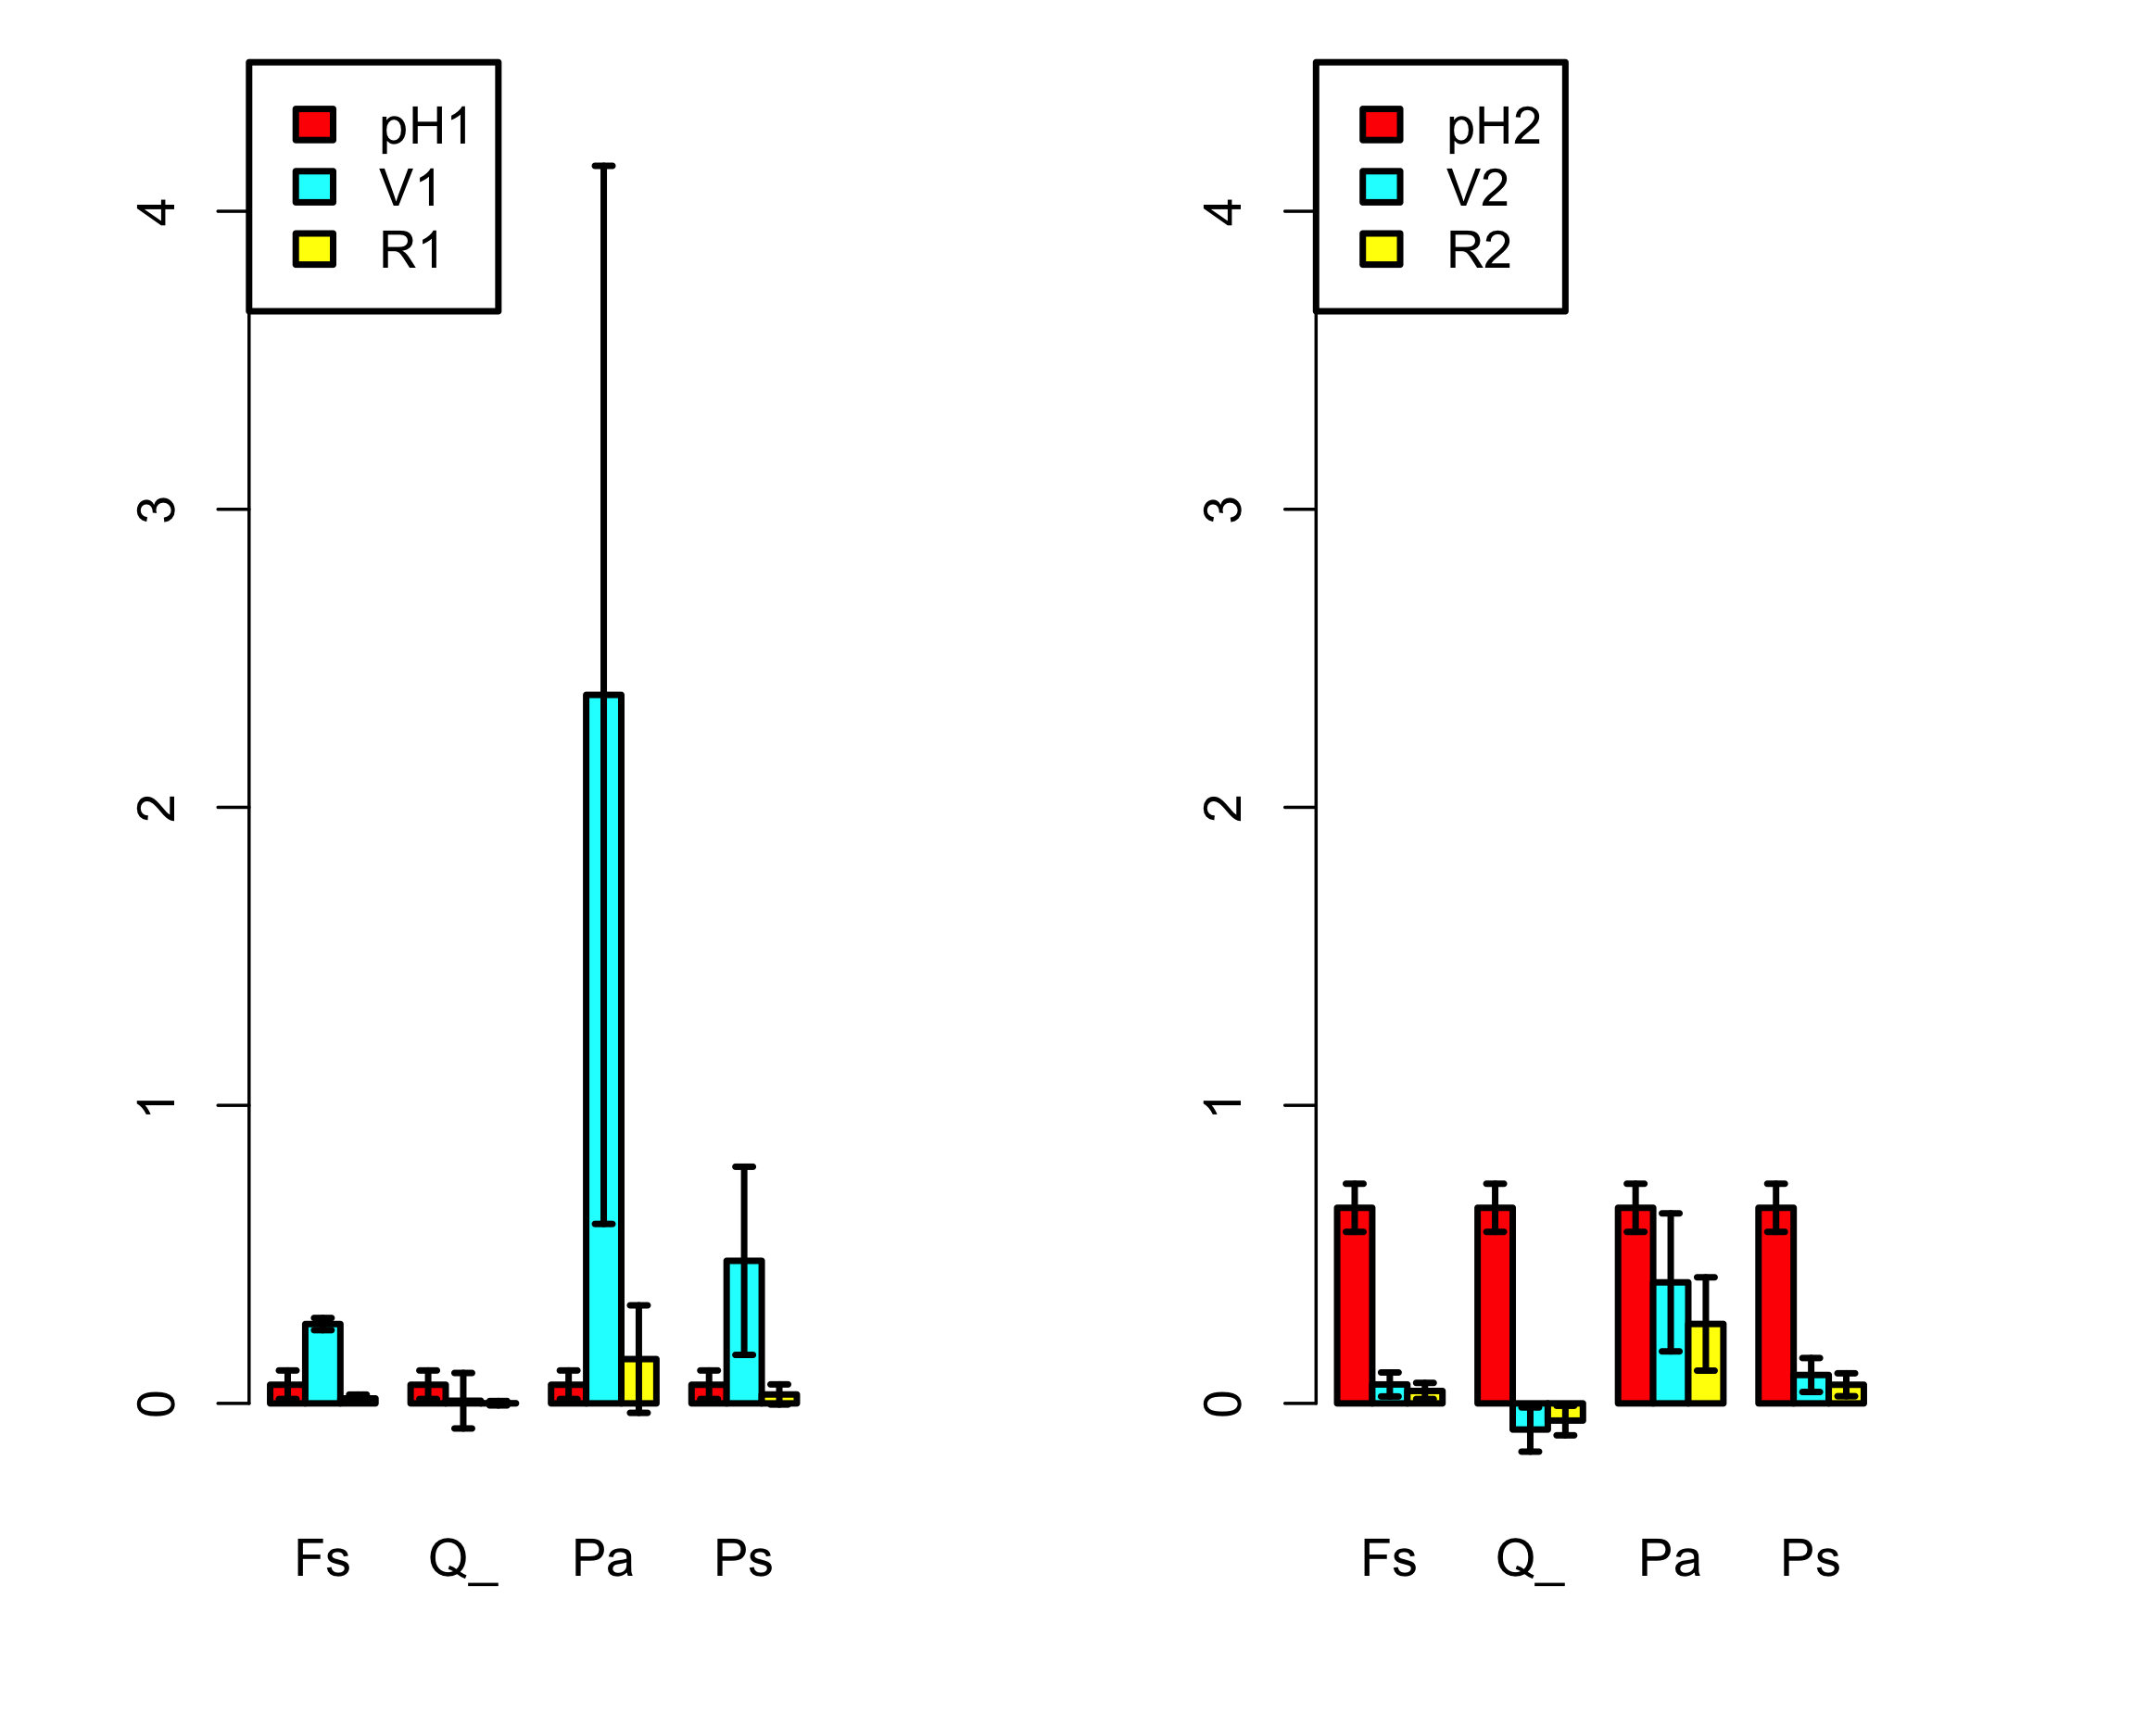
Forest data from Germany: Multi-threshold PRA

Slide 58
Forest data from Germany: EXERCISE 2
Change code: choose a series of multiple thresholds.
Discuss limitations of the multiple-threshold-PRA.

Slide 59
Forest data from Germany: EXERCISE 2
Change code: choose a series of multiple thresholds.
Discuss limitations of the multiple-threshold-PRA. Possible answers:
Mostly the same as for the single-threshold PRA.
Low n even more critical here?
…

Slide 60
Continuous single-threshold PRA
Retrieving total (single-threshold) PRA

Slide 61
Extending the PRA from 2 risk-components to 3
64 different
2-component PRAs at cell level:
1 single
3-component PRA at regional level:
P[H] = 0.27
Q = 37/64
V = 0.26
R = 0.04

Slide 62
Extension to R = Q p[H] V
g m⁻² y⁻¹
-
g m⁻² y⁻¹
R = p[H] V
g y⁻¹
m²
g m⁻² y⁻¹
-
R = Q p[H] V
Q = area (or # individuals) exposed to the risk factor

Slide 63
Interacting hazards

Slide 64
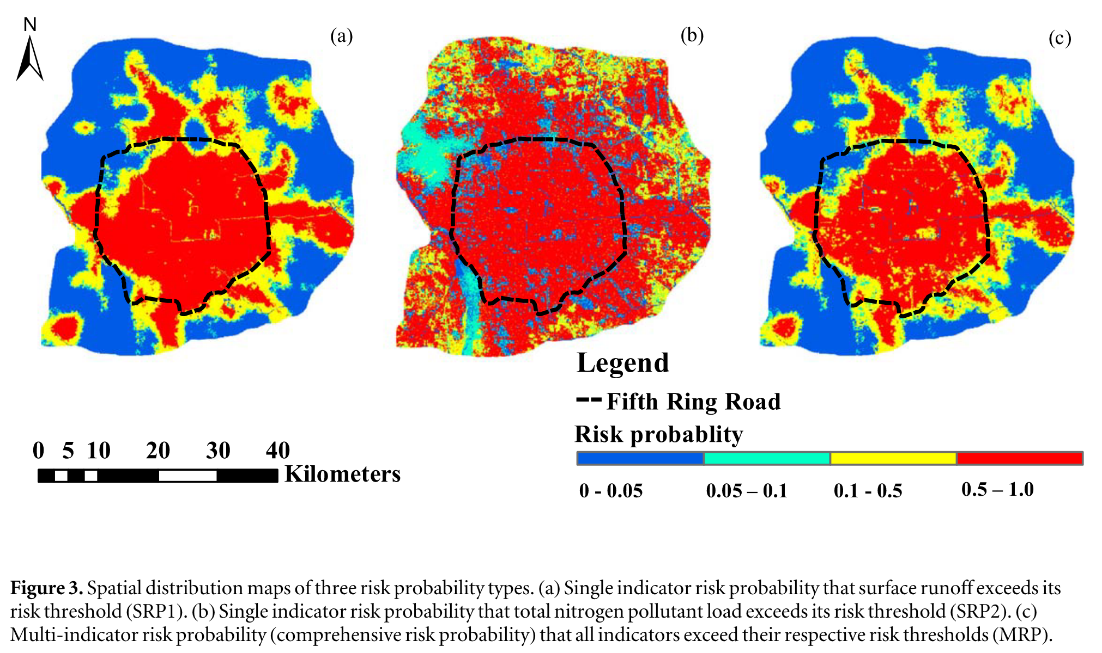
Liu et al. (2020). A new risk probability calculation method for urban ecological risk assessment
Two marginal hazard distributions
Joint distribution formed by copula

Slide 65
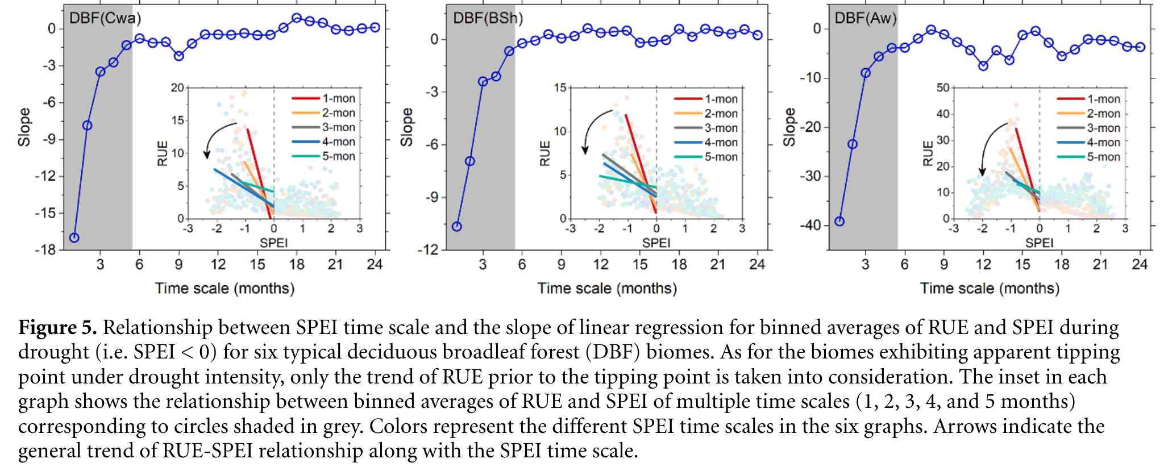
Chen et al. (2020). The collapse points of increasing trend of vegetation rain-use efficiency under droughts

Slide 66
PRA for heatwaves (T>30°C) as f(mean(T),sd(T))

Slide 67
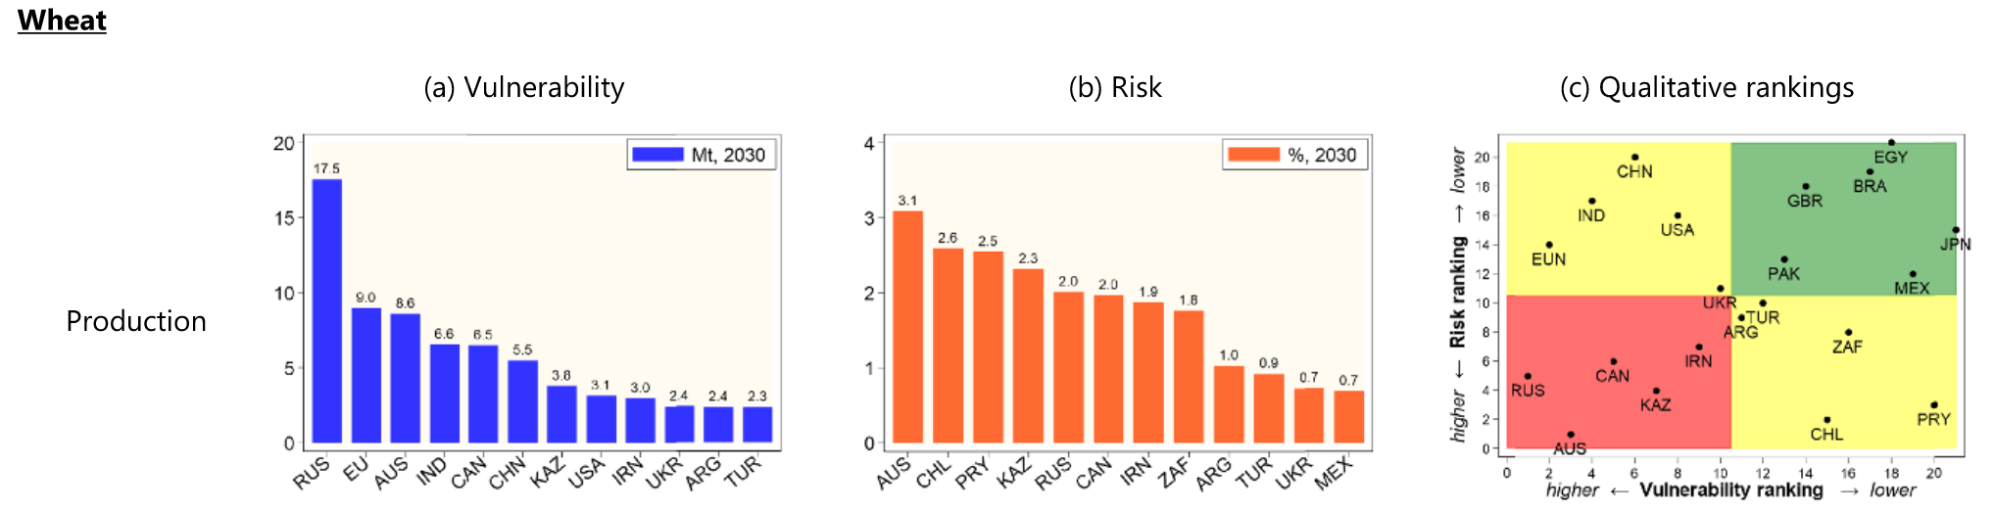
Chatzopoulos et al. (2021). Potential impacts of concurrent and recurrent climate extremes on the global food system by 2030
Concurrent climate extremes
Recurrent climate extremes
V_{glob} = f(spatial distrib. of H)
V_{glob} = f(temporal distrib. of H)

Slide 68
Example of H-interaction with modelled data
Make models that generate values for two or three different hazards. Examine two different versions:
Assume the p[Hi] are independent
Assume correlations
See my handwritten note (single A4)

Slide 69
4. Introduction to BDT
USGS CC PDM 1.0
Workshop IBS-Germany & DVFFA, Lübeck, 2025-09-24-26

Slide 70
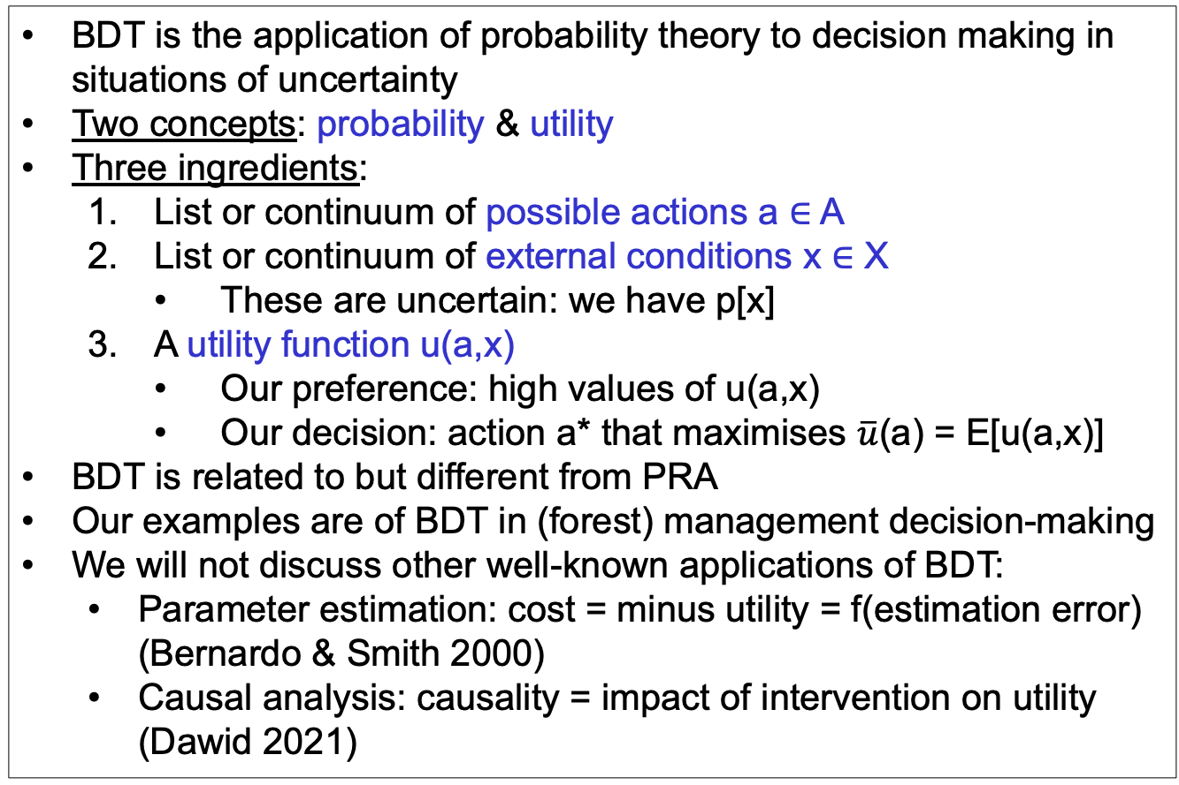
Bayesian Decision Theory (BDT)
BDT is the application of probability theory to decision making in situations of uncertainty
Two concepts: probability & utility
Three ingredients:
List or continuum of possible actions a ∈ A
List or continuum of external conditions x ∈ X
These are uncertain: we have p[x]
A utility function u(a,x)
Our preference: high values of u(a,x)
Our decision: action a* that maximises $\overline{u}$(a) = E[u(a,x)]
BDT is related to but different from PRA
Our examples are of BDT in (forest) management decision-making
We will not discuss other well-known applications of BDT:
Parameter estimation: cost = minus utility = f(estimation error) (Bernardo & Smith 2000)
Causal analysis: causality = impact of intervention on utility (Dawid 2021)

Slide 71
Graphical models: From PRA to BDT
PRA
BDT
u
z
z
x
a
x
p[x,z] =
p[x] p[z|x]
p[x,z,u|a] =
p[x] p[z|a,x] p[u|a,z]

Slide 72
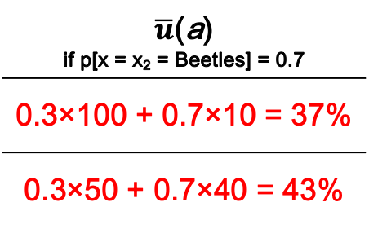
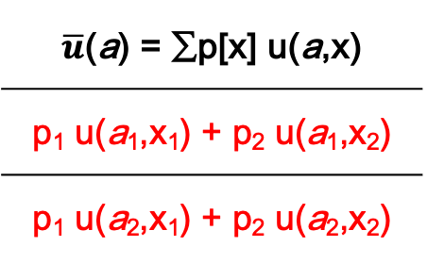
Utility matrix for discrete u(a,x)
 | x = x₁ | x = x₂
a = a₁ | u(a₁,x₁) | u(a₁,x₂)
a = a₂ | u(a₂,x₁) | u(a₂,x₂)
$\overline{u}$(a) = ∑p[x] u(a,x)
p₁ u(a₁,x₁) + p₂ u(a₁,x₂)
p₁ u(a₂,x₁) + p₂ u(a₂,x₂)
u
z
% Tree survival | No beetles | Beetles
No thin | 100% | 10%
50% thin | 50% | 40%
$\overline{u}$(a) if p[x = x₂ = Beetles] = 0.7
0.3×100 + 0.7×10 = 37%
0.3×50 + 0.7×40 = 43%
a
x
We want to maximise expected utility $\overline{u}$(a), so we choose a₂

Slide 73
Value of Information: Impact on expected utility
Only prior information p[x]:
Specific information y:
Information yet to be received Y = {y}:
‘Perfect’ information so you can always (for every x) choose the best action:

Slide 74
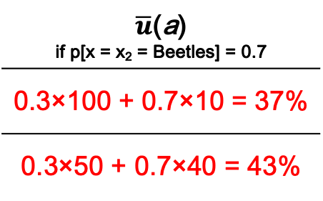
Value of Information in the tree beetle example
If y = {y₁,y₂} and
p[y₁|x₁] = p[y₂|x₂] = 0.6
u
VoI_{partial} = 43.6 – 43 = 0.6%
VoI_{perfect} = 58 – 43 = 15%
z
% Tree survival | No beetles | Beetles
No thin | 100% | 10%
50% thin | 50% | 40%
$\overline{u}$(a) if p[x = x₂ = Beetles] = 0.7
0.3×100 + 0.7×10 = 37%
0.3×50 + 0.7×40 = 43%
a
x

Slide 75
Value of Bad Information in the tree beetle example
What would happen to VoI_{partial} if p[y₁|x₁] = p[y₂|x₂] = 0.5?

Slide 76


Decision tree
u₁₁ = 100%
No beetles
p=0.3
x
$\overline{u}$(a₁) = 37%
No thin
Beetles
p=0.7
u₁₂ = 10%
a
Thin
No beetles
p=0.3
u₂₁ =50%
x
$\overline{u}$(a₂) = 43%
Beetles
p=0.7
u₂₂ =40%

Slide 77
Sequential decisions
No beetles
p=0.3
x
No thin
Beetles
p=0.7
a
Thin
No beetles
p=0.3
x
Beetles
p=0.7

Slide 78
Graphical models: From PRA to BDT
PRA
BDT
u
u
u
cost
benefit
cost
benefit
z
z
z
z
𝜺
x
a
x
a
x
a
x
𝝑
p[x,z] =
p[x] p[z|x]
p[x,z,u|a] =
p[x] p[z|a,x] p[u|a,z]
z = f(a,x,𝝑) + 𝜺
p[x], p[𝝑], p[𝜺]

Slide 79
BDT for forestry
Utility
u
Management costs
cost
benefit
Timber sale
Forest growth
z
𝜺
Model error
Management actions
a
x
𝝑
Model parameters
Climate

Slide 80
Ignoring uncertainties and errors for a moment ...
100.00
--------
Model
YC = £ 180.00 ha⁻¹ y⁻¹
WUE
Irrigation
u
YC
Rain
200.00
-----
300.00
--------
z = 0.01 (x + a)
u = 30 z - 0.5 a
£ 0.00
ha⁻¹ y⁻¹
cost
benefit
£ 180.00 ha⁻¹ y⁻¹
Timber
price
Irrigation costs
10
---
YC = 6
m³ ha⁻¹ y⁻¹
z
𝜺
a
x
𝝑
400
--
Irrigation = 0 mm y⁻¹
Rain = 600 mm y⁻¹
WUE = 0.01
m³ ha⁻¹ mm⁻¹

Slide 81
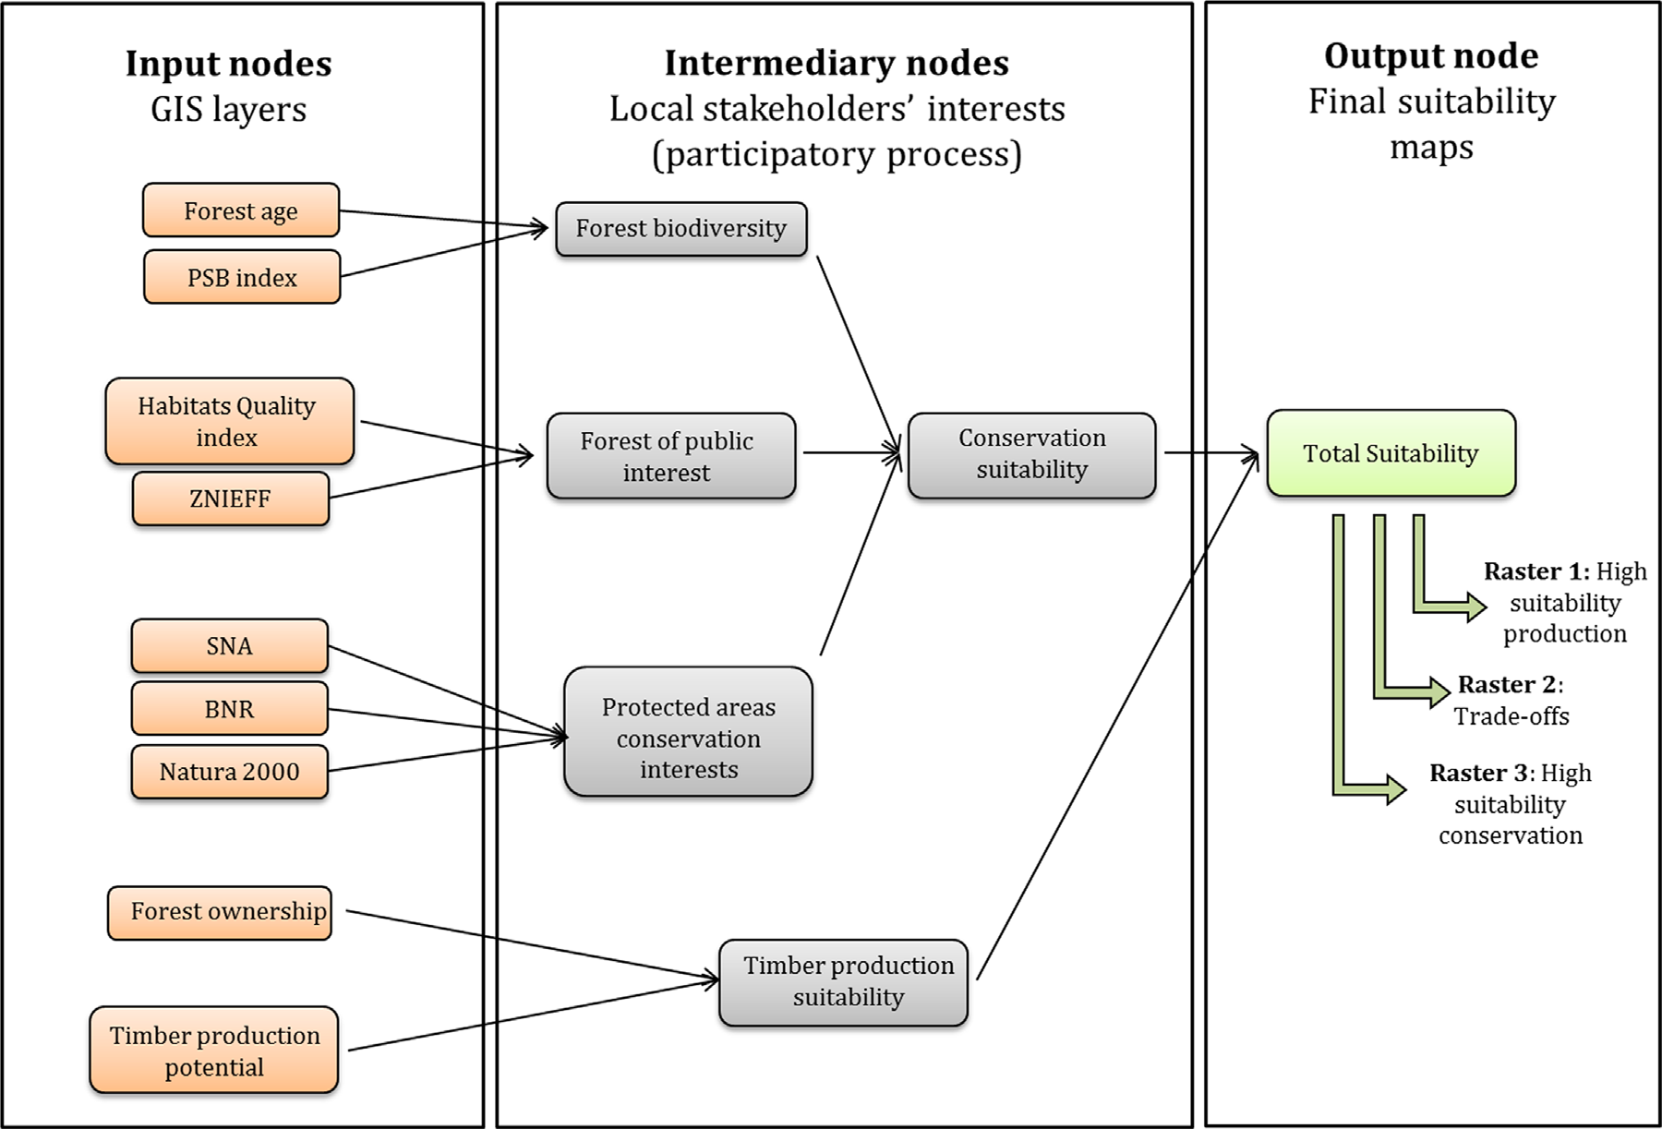
Gonzales-Redin et al. (2016)
Gonzalez Redin, J. et al. (2016). Spatial Bayesian belief networks as a planning decision tool for mapping ecosystem services trade-offs on forested landscapes. Environmental Research 144: 15-26.

Slide 82
Now with all uncertainties!
u
E[u|a] = ∫ E[u(a,x)] p[x] dx
cost
benefit
E[u(a,x)] = ∫ ∫ p[z|x,θ,a] p[θ|y] dθ p[x] dx
z
𝜺
p[ε]
p[θ|y]
p[x]
a
x
𝝑
z = f(a,x,𝝑) + 𝜺
p[x], p[𝝑], p[𝜺]
p[ε_{y}]
p[θ]

Slide 83
5. Links between PRA and BDT
USGS CC PDM 1.0
Workshop IBS-Germany & DVFFA, Lübeck, 2025-09-24-26

Slide 84
6. General discussion
USGS CC PDM 1.0
Workshop IBS-Germany & DVFFA, Lübeck, 2025-09-24-26

Slide 85
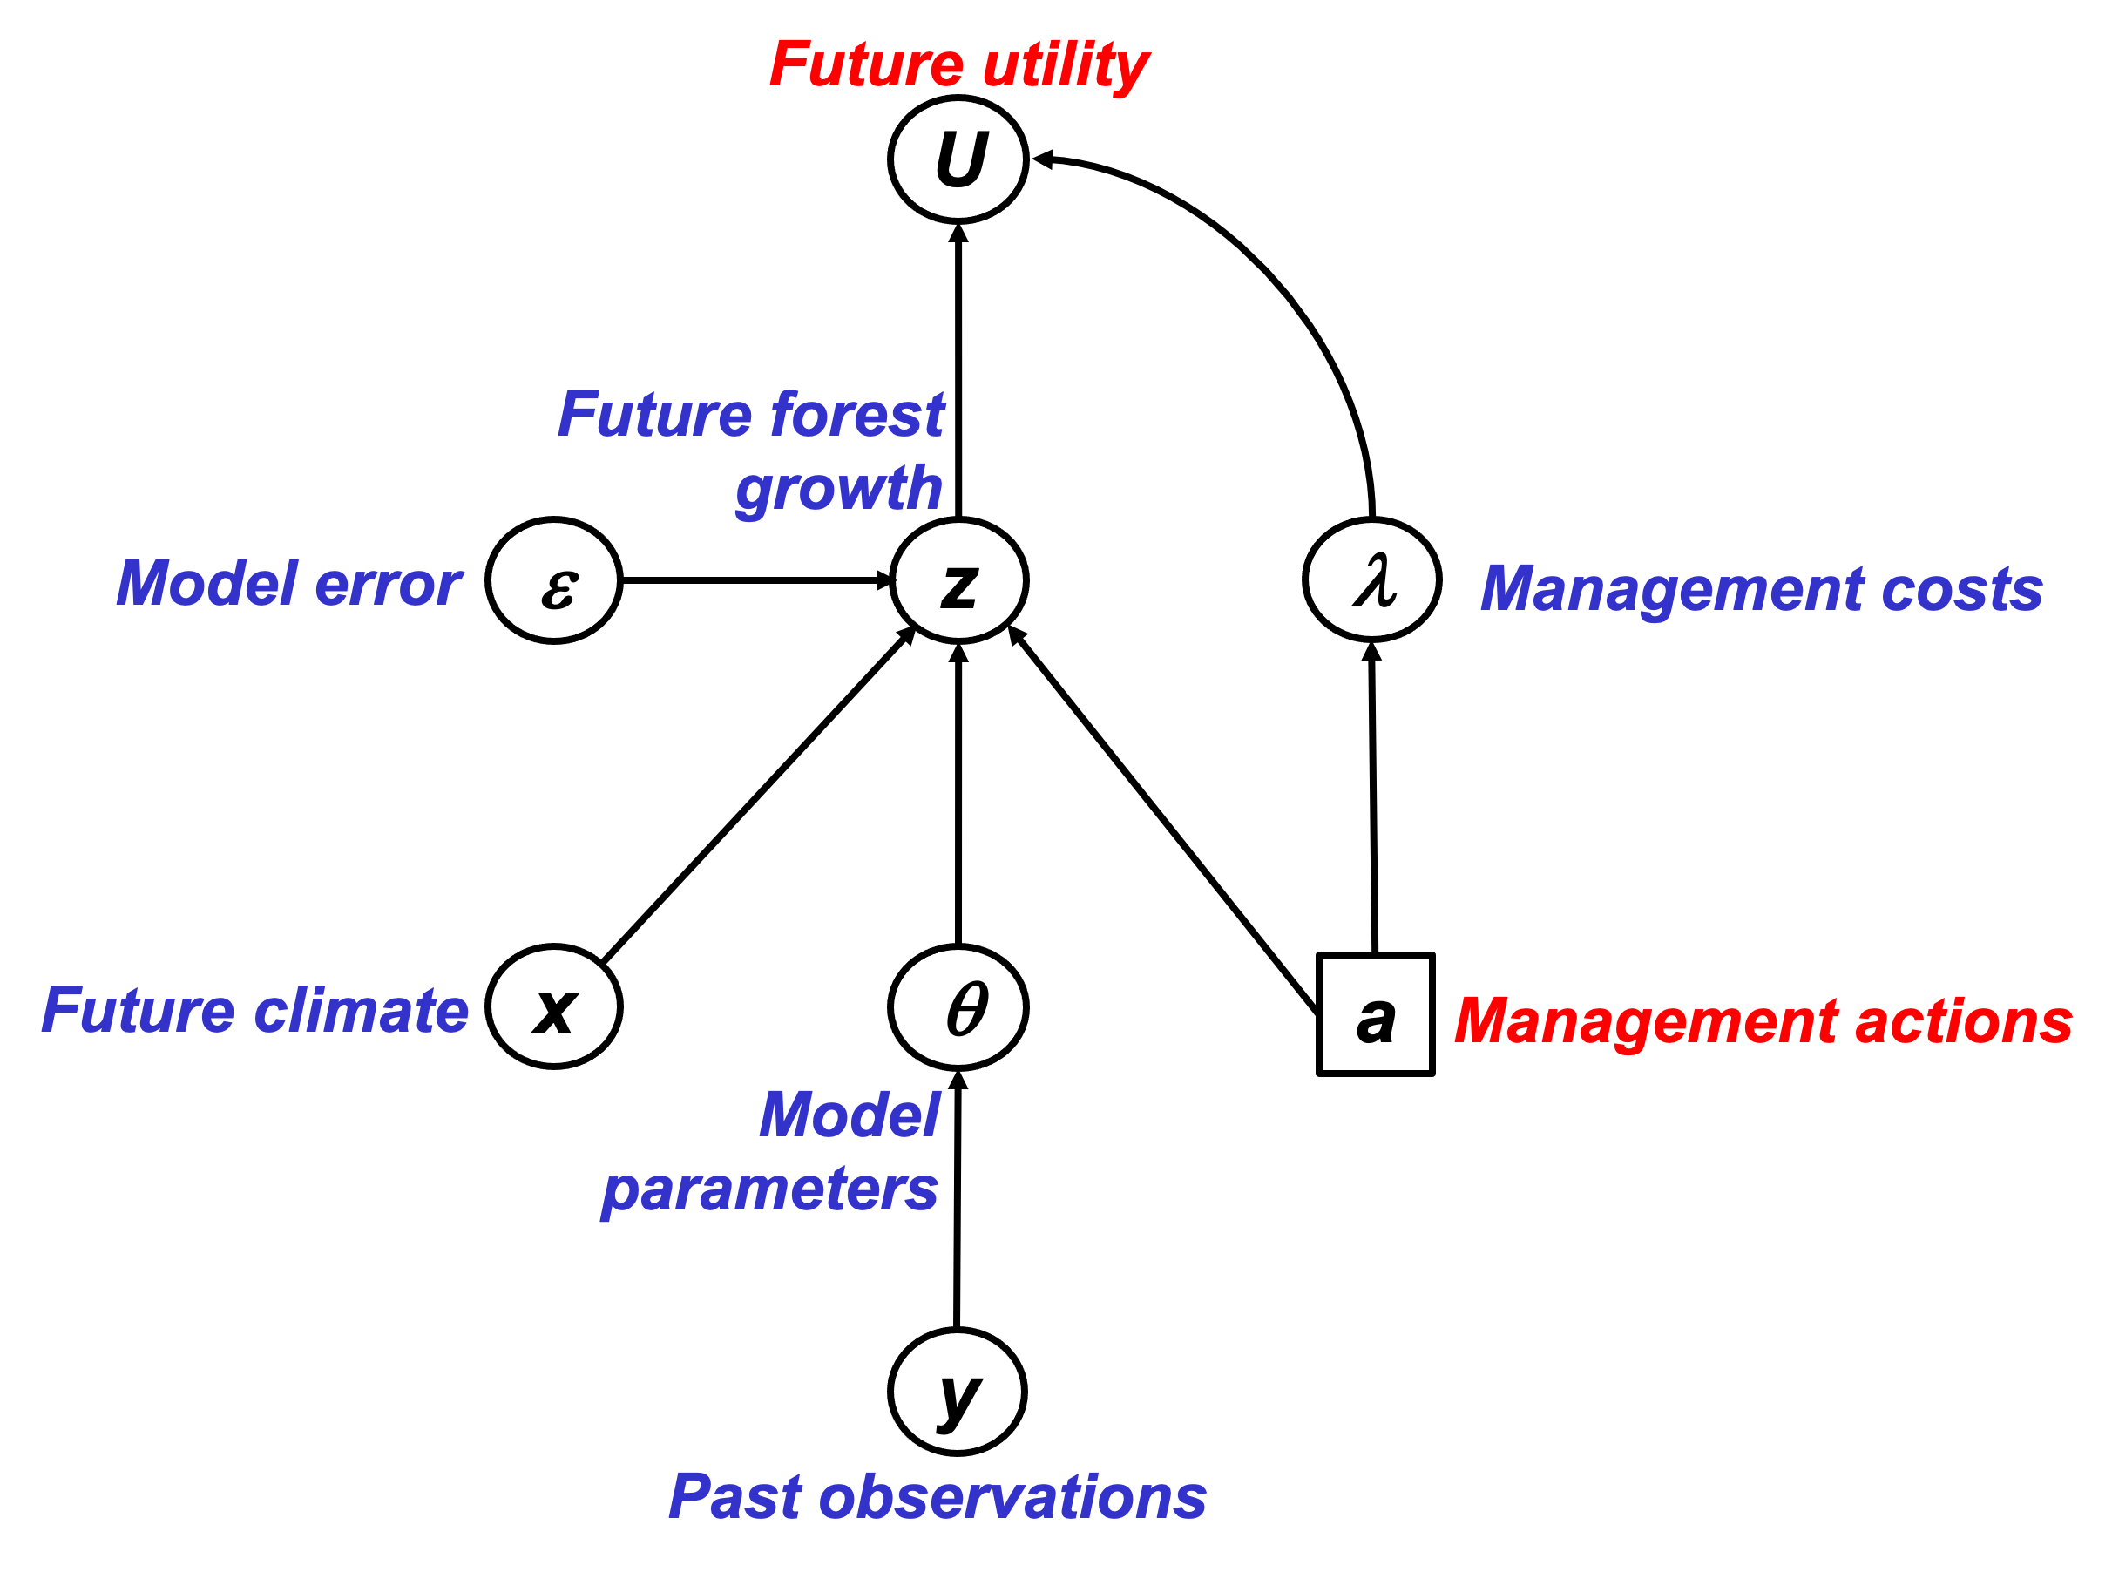
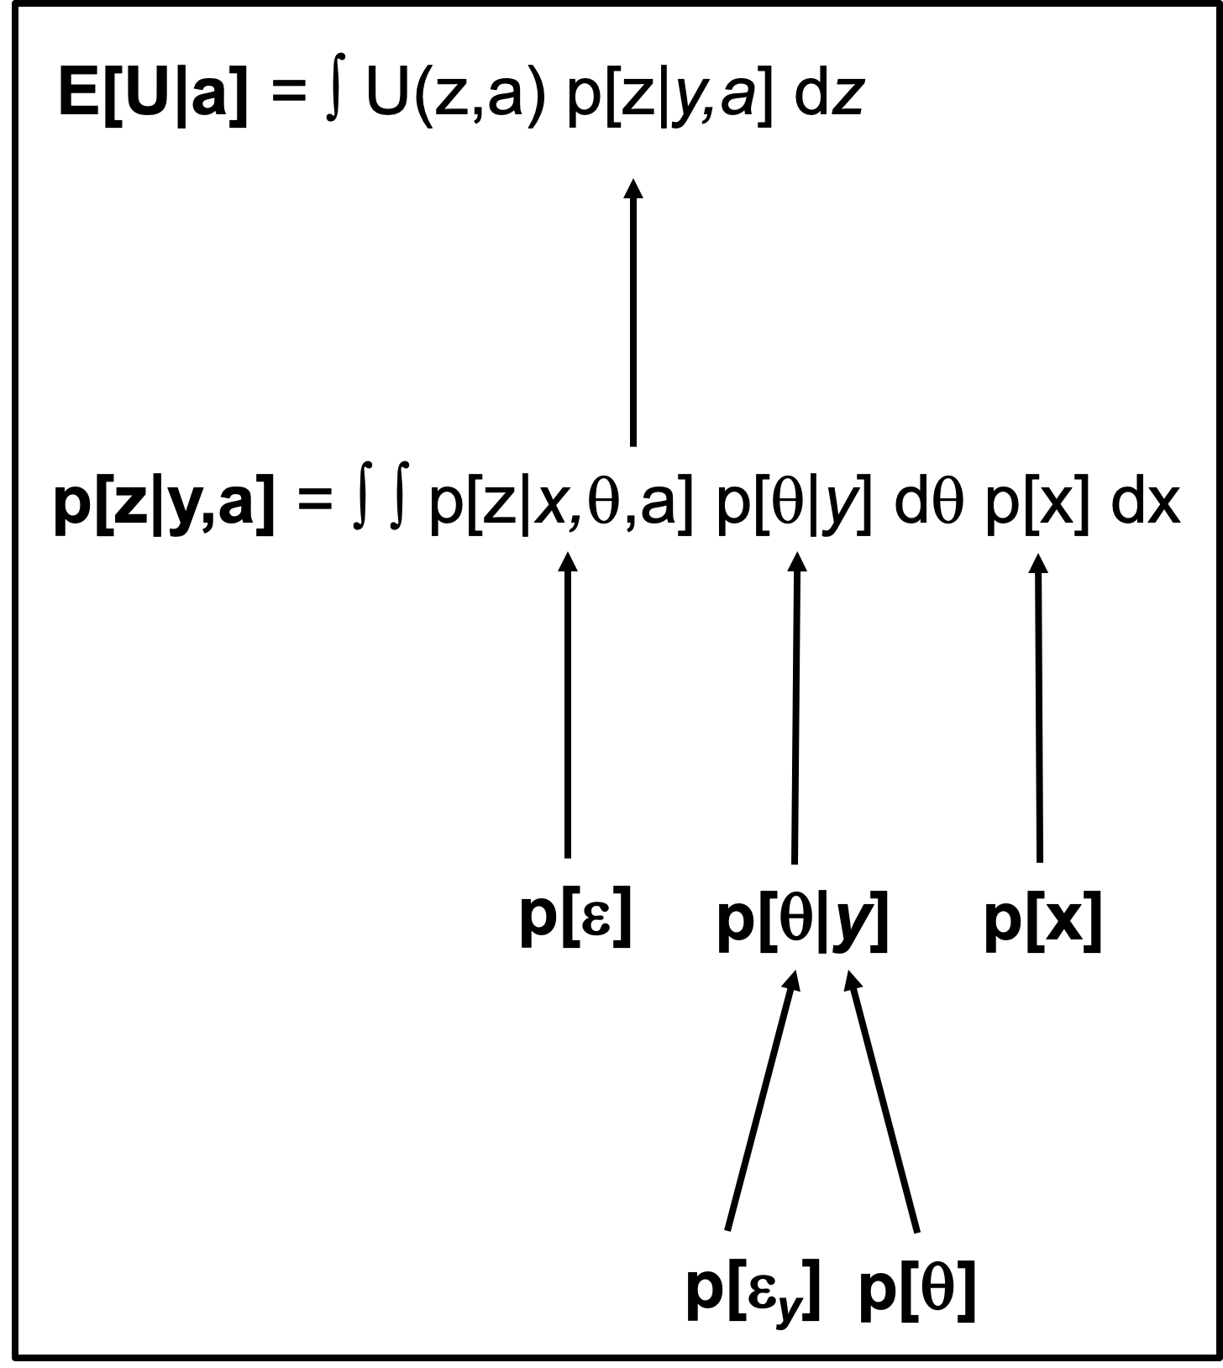
Theory development: PRA & BDT
Probabilistic Risk Analysis (PRA)
Risk = Expected loss = probability(Hazard) * Vulnerability
p(Drought)
Risk
Vulnerability
Van Oijen et al. (2013, 2014, 2019)
Bayesian Decision Theory
(BDT)

Slide 86

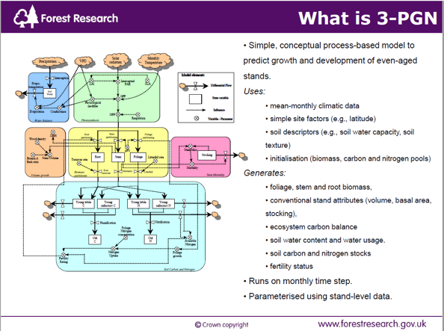
Data & Process-Based Modelling (PBM)
Data
Performance of conifer spp. in UK, Spain, Finland
Environmental conditions (soil, past & future climate)
Forest management
Model drivers
Model test data
Model calibration data
PBM
BASFOR, 3PGN, …
Quantifying past & future forest performance
Analysing forest vulnerability to drought
Analysing impacts of management

Slide 87
Project flowchart & Decision Support System (DSS)
Data
PRA
DSS
PBM
BDT

Slide 88
Deeper analysis of p[H] and V
Analysing p[H]. Compare with FTA in systems with binary outcomes. Use BBN. Or PBM.

Slide 89
Lecina-Diaz et al. (2020)

Slide 90
Lecina-Diaz et al. (2020)

Slide 91
PRAFOR (2020-2022) - Why?
Need to know where/what to plant to ensure 'climate-smart' forestry (carbon sequestration)
To underpin land-use decision making needs information on risks in a way that supports decisions making to mitigate drought (and other) risks.

Slide 92
PRAFOR objectives
1. Show under which conditions p[H], E and V can be treated as independent variables.
2. Show under which conditions uncertainties in p[H], E and V can be quantified analytically.
3. Derive numerical approximation algorithms for non-analytical conditions.
4. Show how the PRA is a special case of Bayesian Decision Theory and compare strengths and weaknesses of PRA vs. full BDT.
5. Use observational data to analyse risks from global change to forests in the UK, Spain and Finland.
6. Use outputs from forest simulation modelling to predict and analyse future risks.
7. Analyse the simulation model to identify the key system properties that determine vulnerability.
8. Produce an interactive app for probabilistic risk analysis including uncertainty quantification.
Theory
Application
Analysis
Process sensitivities, Lag-effects, Adaptation, ...
Communication

Slide 93
Outlook
Theory has been tested on virtual data sets, confirming the accuracy of formulas for uncertainty quantification
Next steps:
Application to real forest data
PRA theory to be embedded in Bayesian decision-theory (BDT) framework
PRA or BDT to be embedded in ESC, the existing Decision Support System of Forest Research U.K.

Slide 94
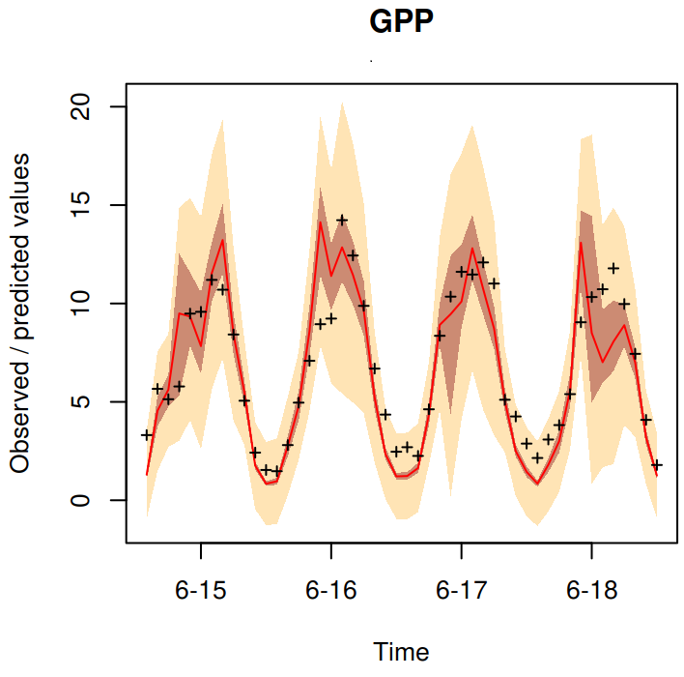
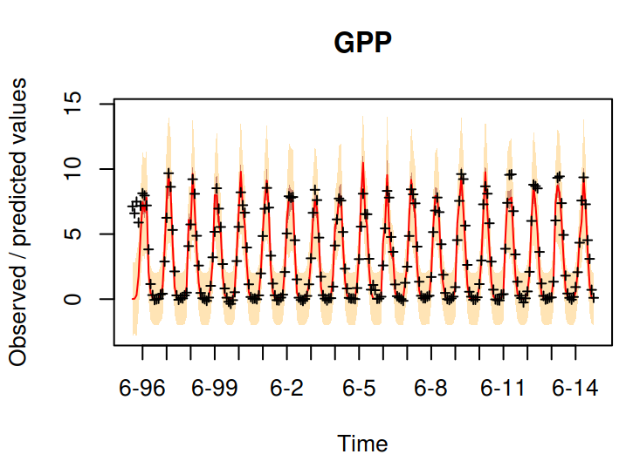
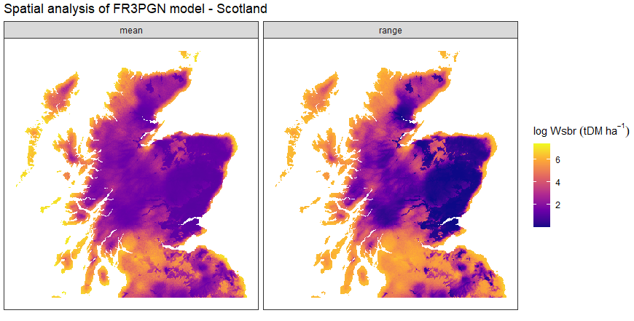
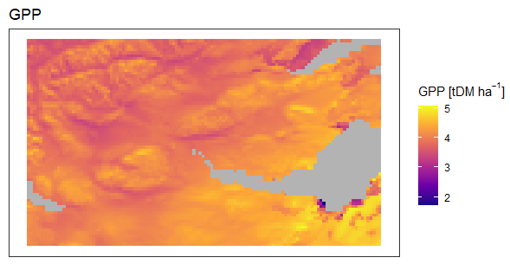
Process-model based drought vulnerability
Two process-based models (BASFOR, 3PGN)
Identify key factors drive present and future forest drought vulnerability.
Bayesian Calibration to reduce uncertainty in model parameters
Forest data (UK, Spain and Finland)
Quantify uncertainty in model error.

Slide 95
ESC: a DSS for tree suitability estimation
• National scale guidance published in 2001.
• Complemented by a computer based decision support system, field survey pack and training course.
• ArcView extension.
• Now embedded in many aspects of GB Forestry.

Slide 96
PRAFOR objectives
1. Show under which conditions p[H], E and V can be treated as independent variables.
2. Show under which conditions uncertainties in p[H], E and V can be quantified analytically.
3. Derive numerical approximation algorithms for non-analytical conditions.
4. Show how the PRA is a special case of Bayesian Decision Theory and compare strengths and weaknesses of PRA vs. full BDT.
5. Use observational data to analyse risks from global change to forests in the UK, Spain and Finland.
6. Use outputs from forest simulation modelling to predict and analyse future risks.
7. Analyse the simulation model to identify the key system properties that determine vulnerability.
8. Produce an interactive app for probabilistic risk analysis including uncertainty quantification.
Theory
Application
Analysis
Process sensitivities, Lag-effects, Adaptation, ...
Communication

Slide 97
Appendices
USGS CC PDM 1.0
Workshop IBS-Germany & DVFFA, Lübeck, 2025-09-24-26

Slide 98
Condition for V being threshold-independent

Slide 99
Six datasets where E[z|x] = a + b F_{x}[x]
x
p[x]
z
a
b F_{x}[x]
𝜺
x_U <- runif(n) ; z_U <- 0.5 + x_U/2 + rnorm(n,0,0.05)
x_E <- rexp(n) ; z_E <- 1 - exp(-x_E)/2 + rnorm(n,0,0.05)
x_B <- rbeta(n,5,1) ; z_B <- 0.5 + pbeta(x_B,5,1)/2 + rnorm(n,0,0.05)
x_t <- rt(n,1,30) ; z_t <- 0.5 + pt(x_t,1,30)/2 + rnorm(n,0,0.05)
x_G <- rnorm(n) ; z_G <- 0.5 + pnorm(x_G)/2 + rnorm(n,0,0.05)
x_L <- rnorm(n) ; z_L <- 0.5 + 0.5/(1+exp(-2*x_L)) + rnorm(n,0,0.05)
We now will do single-threshold PRA on each of these six datasets.
We vary the location of the threshold: 5% quantile of x, 10%, …, 95%.
(So p[H] will vary accordingly.)

Slide 100
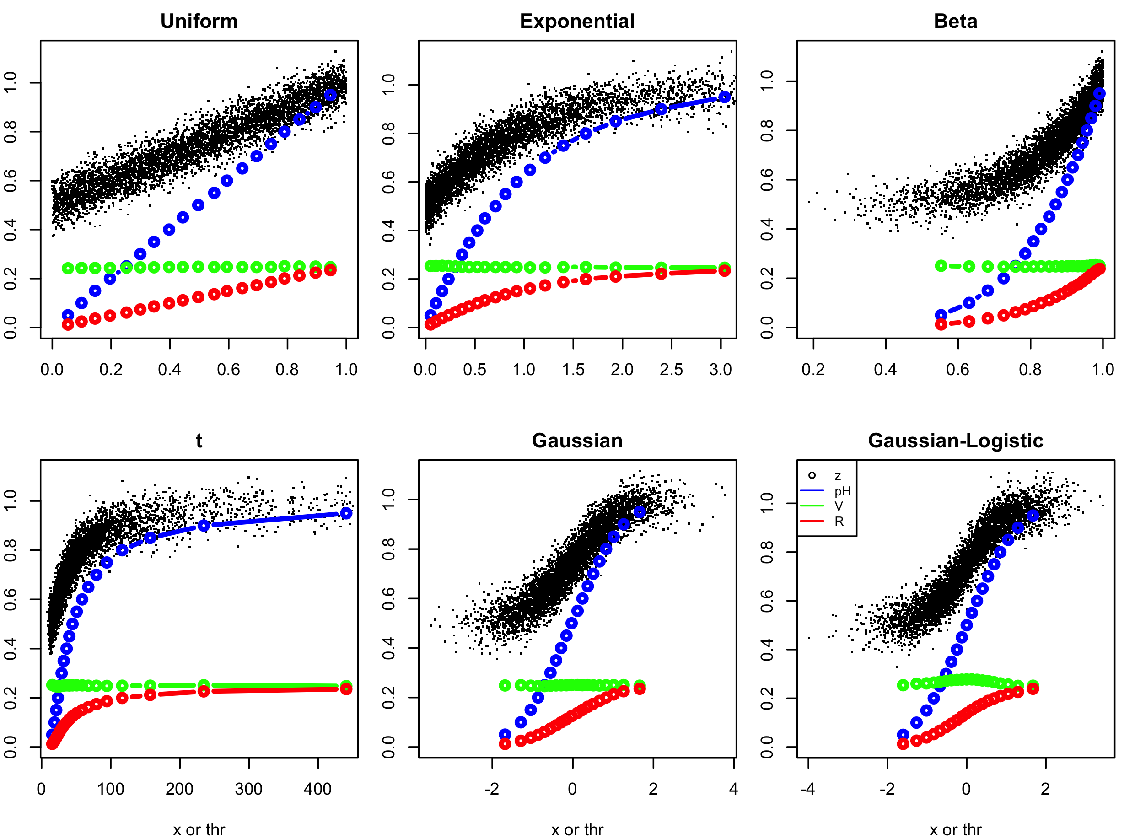
Single-threshold PRA on the six datasets

Slide 101
EXERCISE
What kind of figures do you expect to see if we carry out multi-threshold PRA on these six datasets, using the same 19 threshold levels to define our x-intervals?
Would V be constant, i.e. independent of the x-interval?
How would p[H] vary between the intervals?

Slide 102
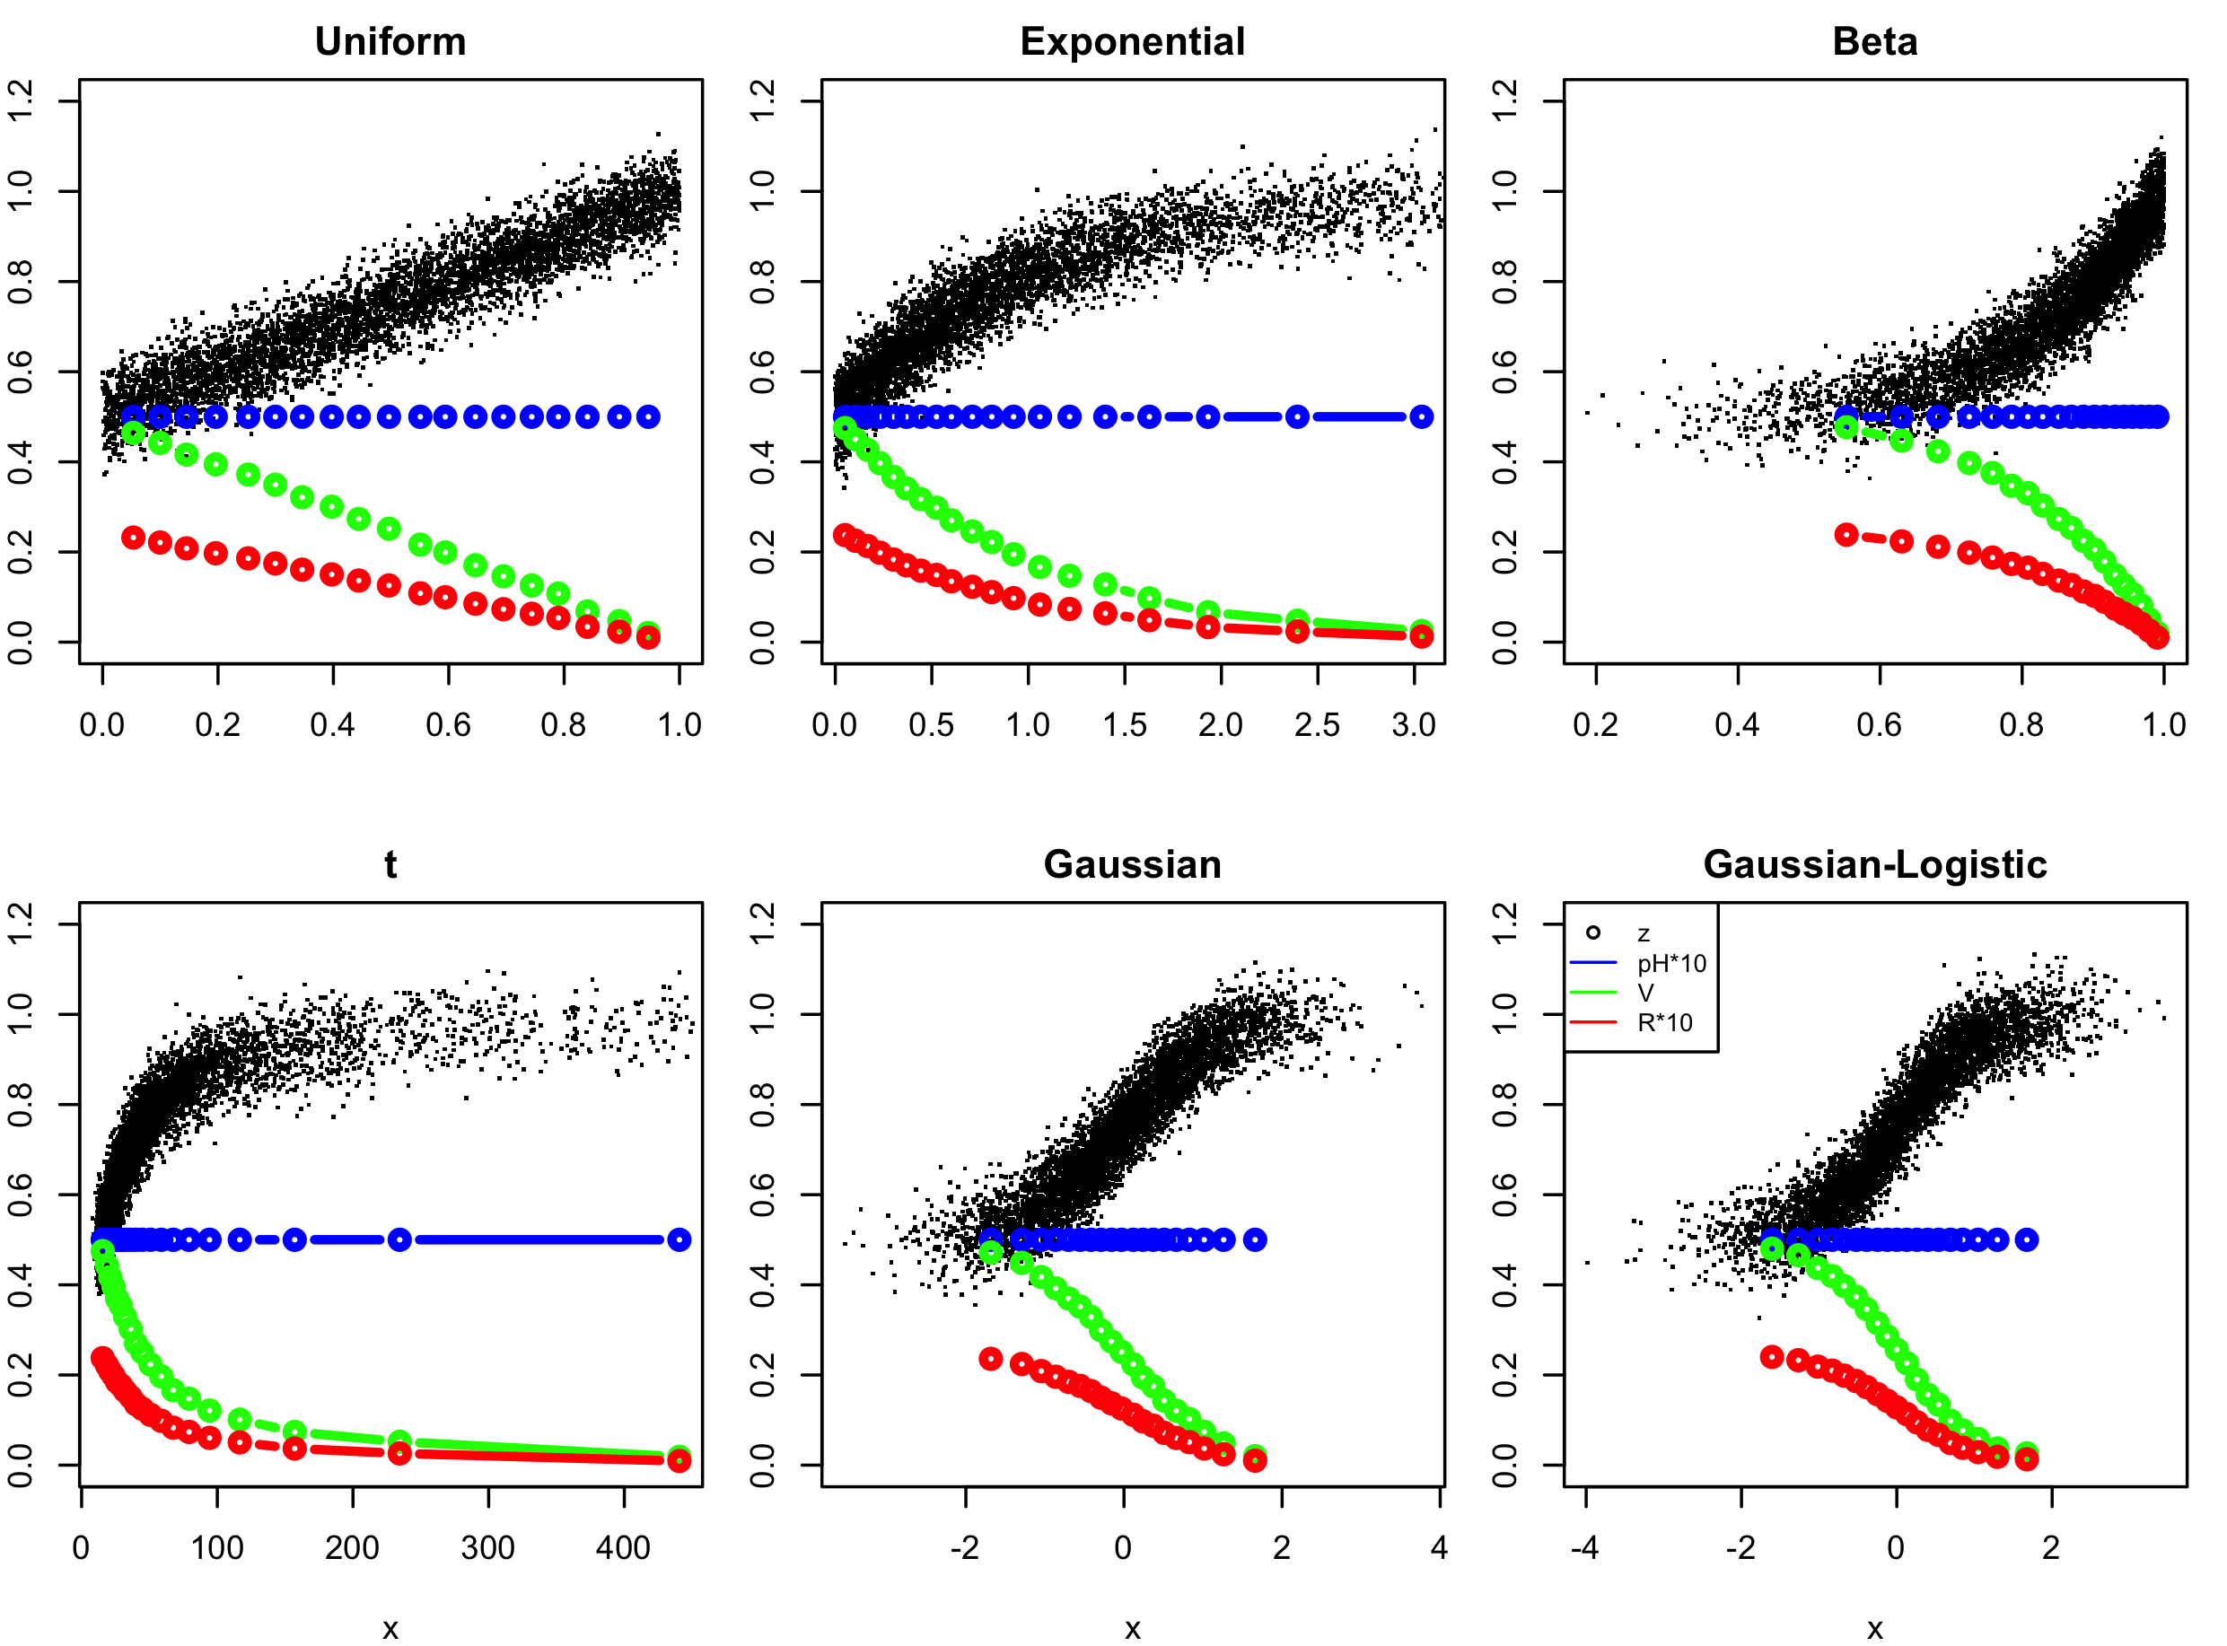
Multi-threshold PRA with equal-p[H] intervals

Slide 103
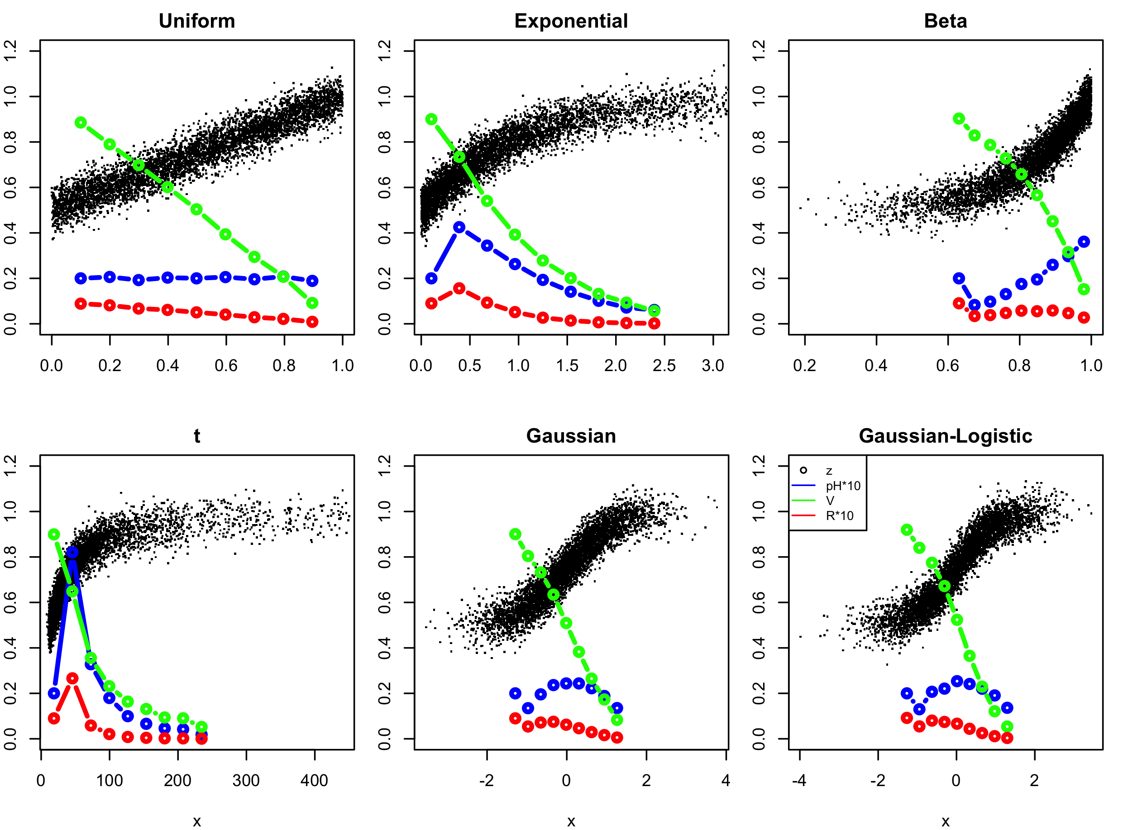
Multi-threshold PRA with equal-x-width intervals

